Slide 1
Water Advocacy Program Water Needs YOU!
Notes:
This is your intro slide – a chance for the presenter to introduce the topic and set the stage. PLEASE READ BELOW TO PREPARE FOR DELIVERING THESE REMARKS!
This PPT and the text in each of the notes sections is intended to provide a specific narrative to WEF Trustees and others who may be addressing large audiences of behalf of WEF, to take 5 minutes to introduce WEF’s Water Advocates (WA) Program and then intentionally walk the audience through the specific steps to scan the WA QR code, select and send a letter to their legislator. The intent is to not just make the audience aware of the program and expect they will send a letter at a later time – experience has shown us that they wont. The speaker must take the time to intentionally work with the audience to do this LIVE…before they start their major remarks/presentation.
The notes provided on each page can be used word for word.

Slide 2
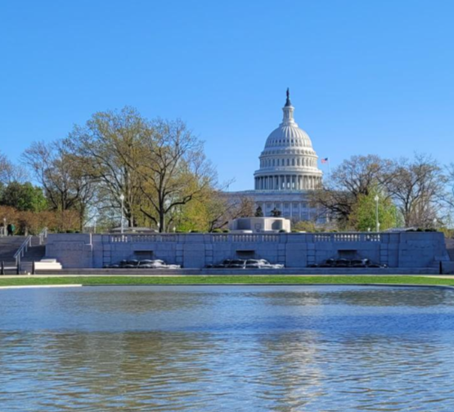
Capitol Hill - where major water decisions are made
Notes:
Why is this important?
Many of the major decisions related to our industry are ultimately made on Capitol Hill – regulatory, funding and other decisions are made by our legislators, so it is CRITICAL that we make sure they are aware of what we do, what we need and what they need to know to make good decisions to support clean water. So much of what we do is under the radar – If we want legislators make good decisions for clean water we need to inform them about at least some basic issues.
We have some options - we can meet legislators, call them or write to them.
WEF has created the WATER ADVOCATES platform to make it really easy for anyone – yes anyone – to send a letter to their legislator on any of several current key water issues.
And that is what we are all going to do – RIGHT NOW.

Slide 3
BUT FIRST….
Notes:
So before I share my presentation/remarks on behalf of WEF, there is something very important I need you all to do.
We are all going to do a brief exercise related to WEF’s Water Advocates program.
Can I get a show of hands as to who in the room is already a Water Advocate –
Pause…do a high level count
….OK there are some, but we really need your support to make that a bigger number. Lets do it !

Slide 4

The Water Advocates Program helps you to reach out to and connect with elected officials on important water quality issues.
TAKE OUT YOUR CELLPHONE
Notes:
So – first I’d like everyone to take out your cellphone – even if you are already signed up for the Water Advocates Program.
I’m going to share a QR code on the screen that I’d like you all to scan.
Were all going to send a letter to our legislators and make them aware of clean water and inform them about what we need

Slide 5

The Water Advocates Program helps you to reach out to and connect with elected officials on important clean water issues.
WEF Water Advocates Program
Notes:
So please scan this QR code – it will take you to WEF’s Water Advocates Program – which helps us all to connect with elected officials on important clean water issues

Slide 6
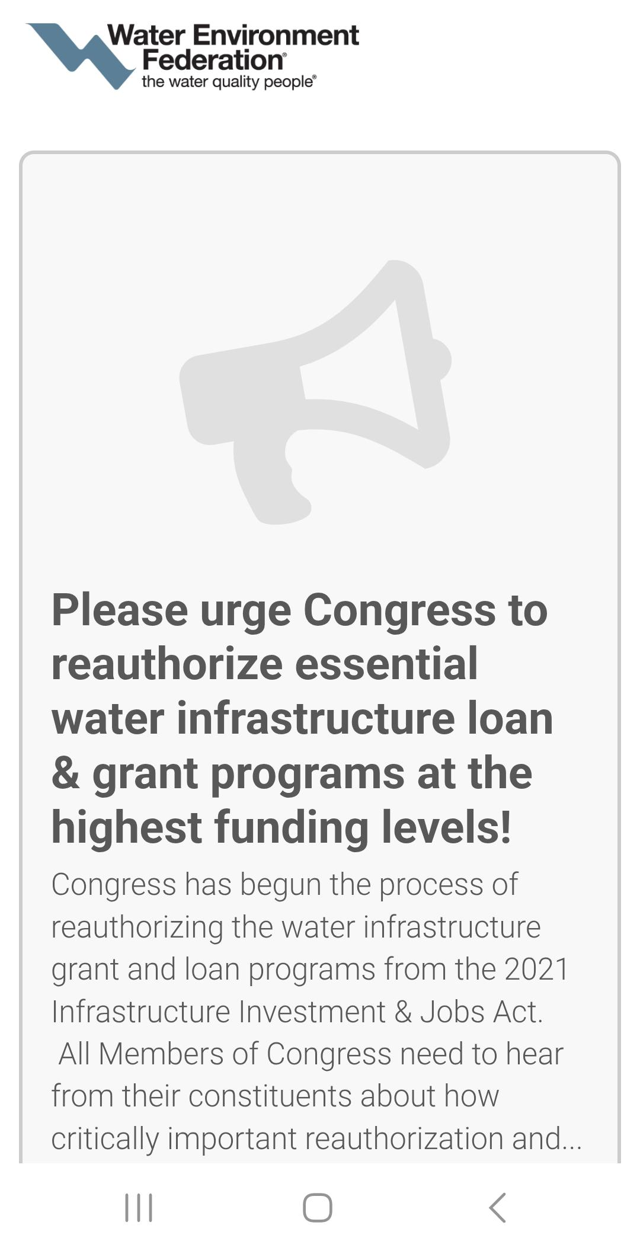
Notes:
When you have scanned the QR code this is what you will see….first off a request to ask Congress to reauthorize essential water infrastructure loan and grant programs at the highest funding levels – a pretty important topic to start with

Slide 7
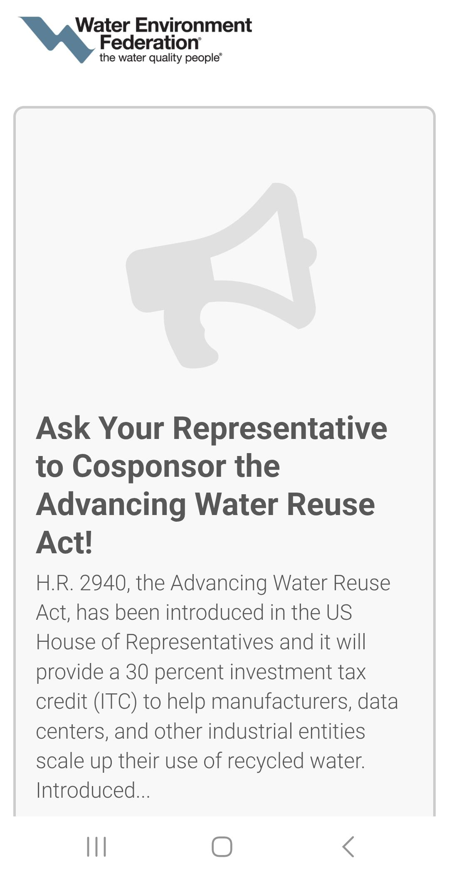
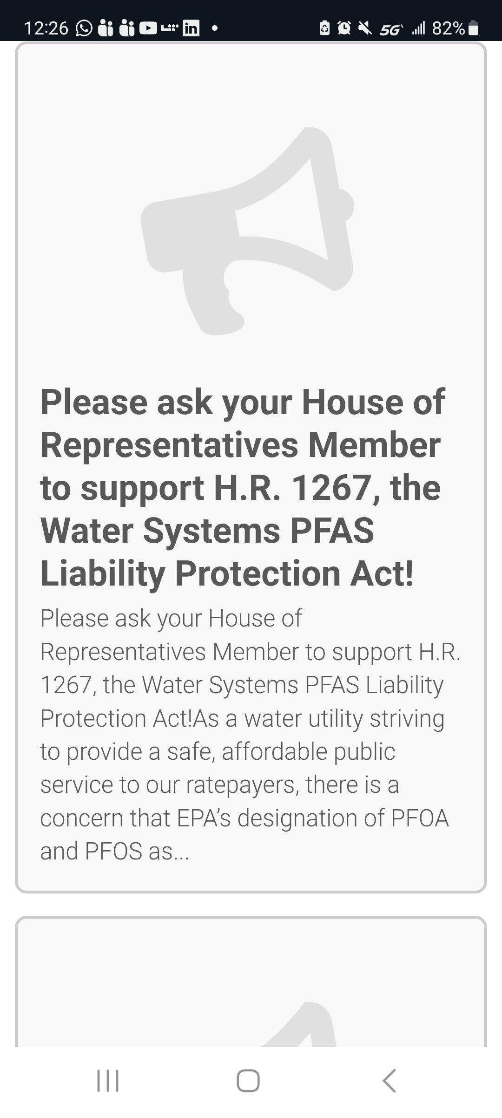
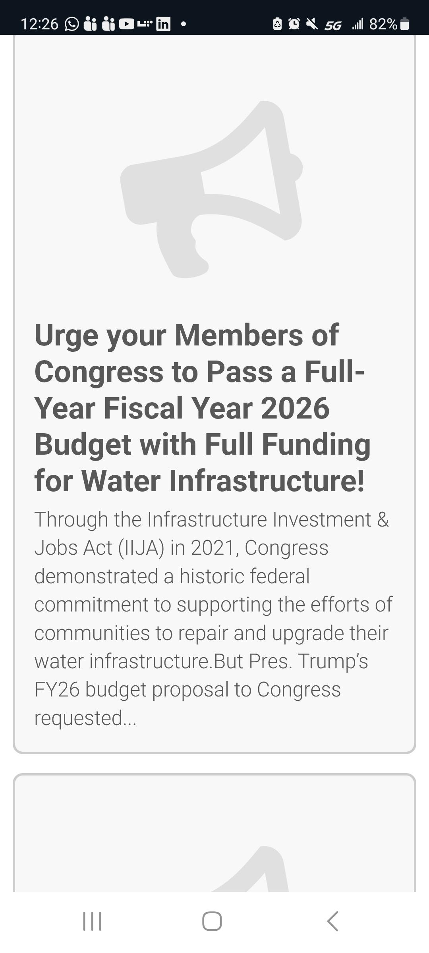
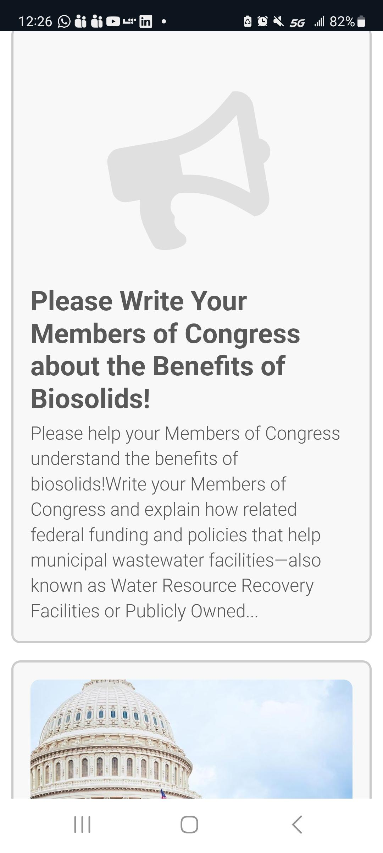
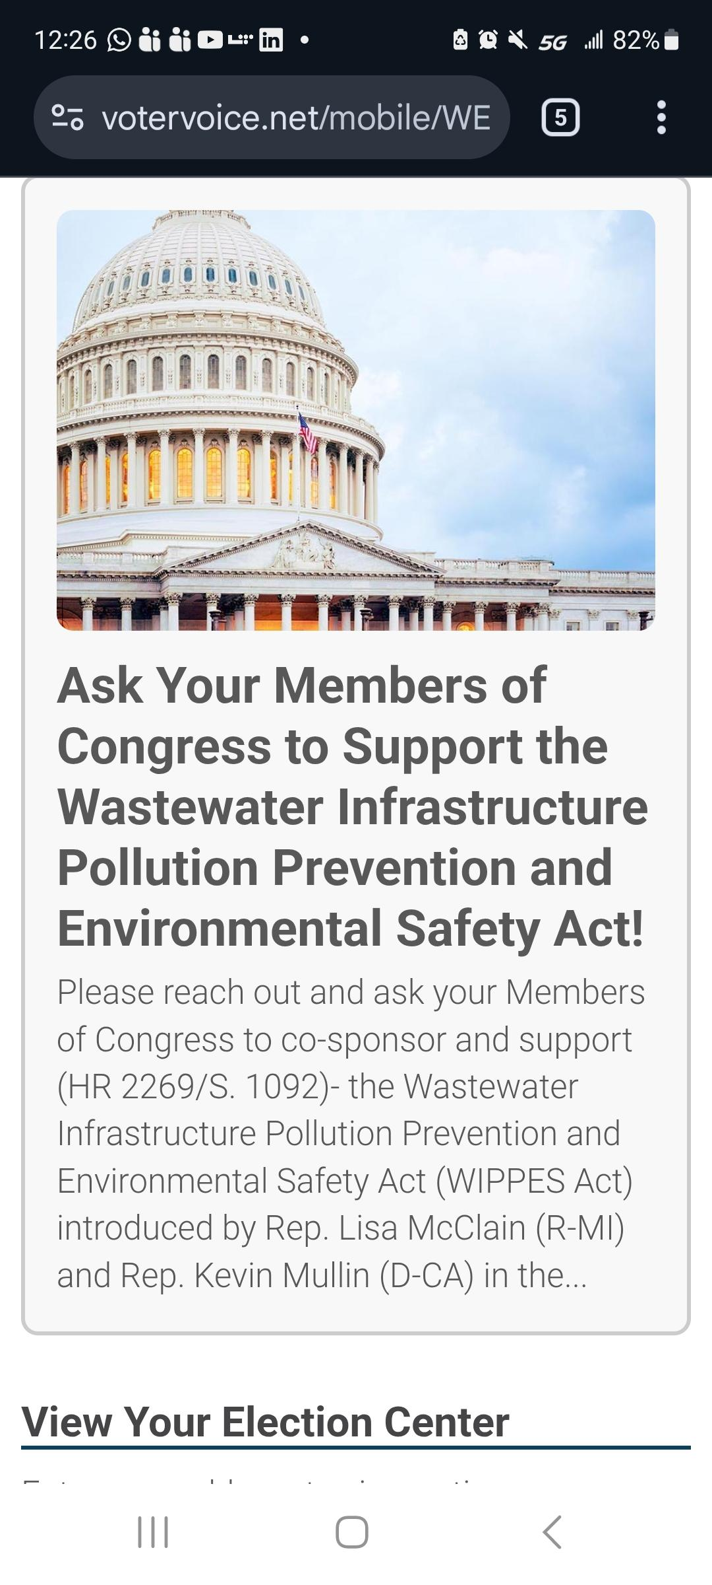
Water Reuse
PFAS
Funding
Biosolids
Wipes Labeling
Notes:
….as you scroll down you’ll see 5 additional topics….on Water Reuse, 2026 Funding, PFAS, Biosolids and Wipes Labeling topics – these are the topics that WEF is currently championing on our behalf. Each of these are topics of letters that you can send to your legislators to inform them. We are going to focus today on the funding topic.

Slide 8
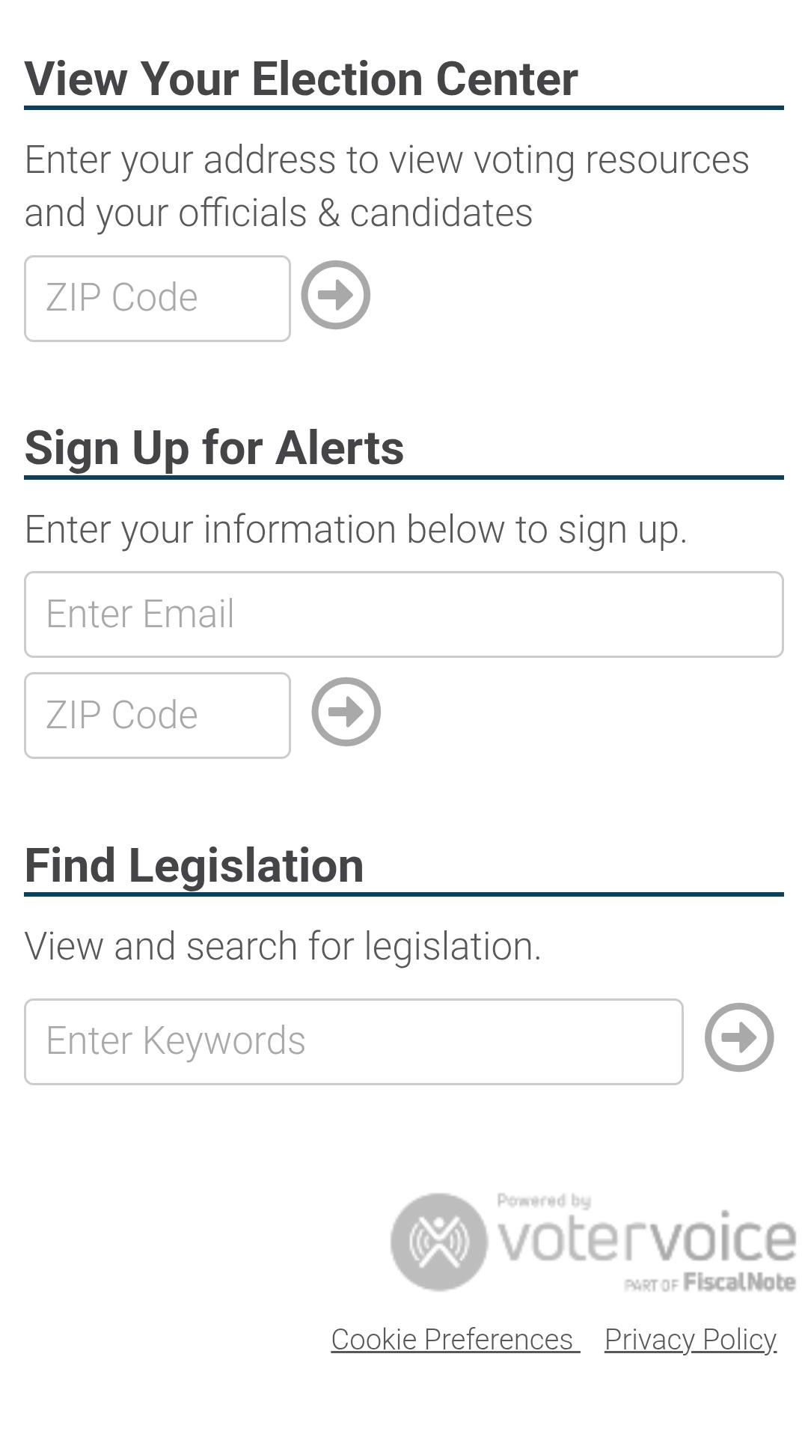
Notes:
When you scroll down you will see this section where you’ll enter a few basic pieces of info…zip code, email etc

Slide 9
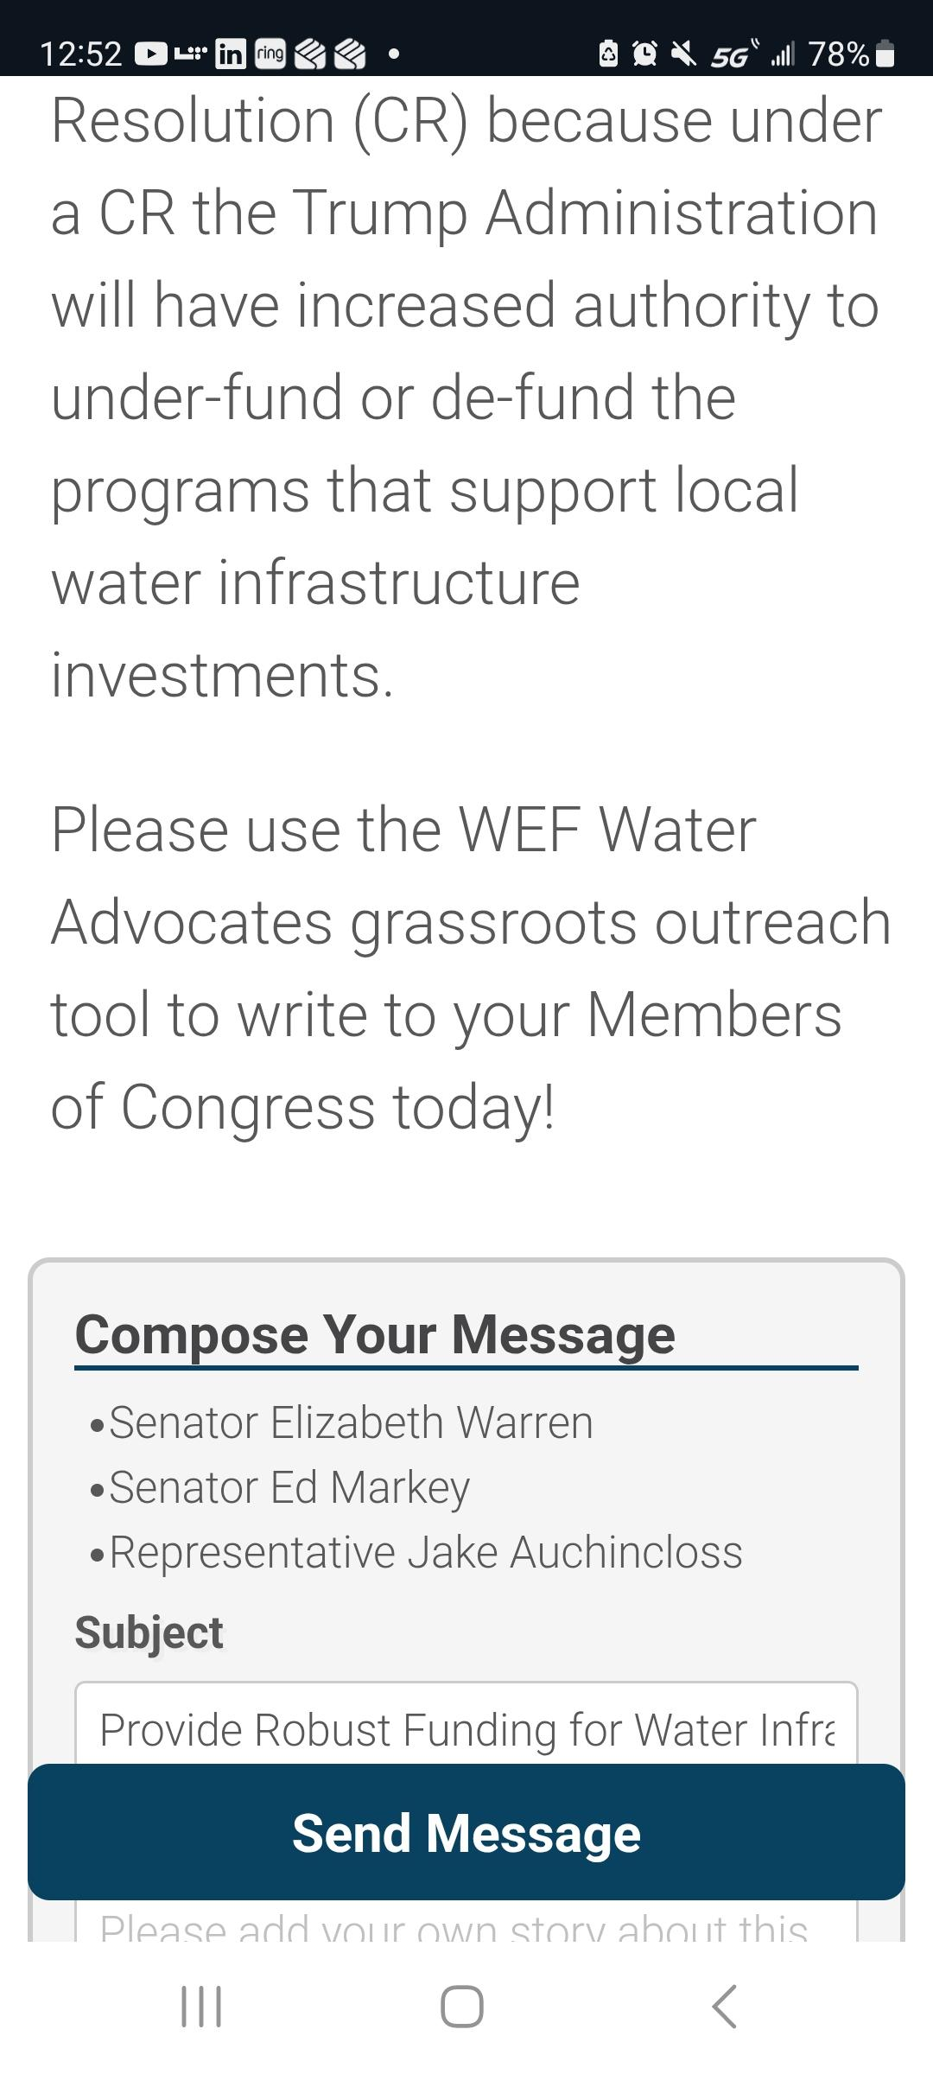
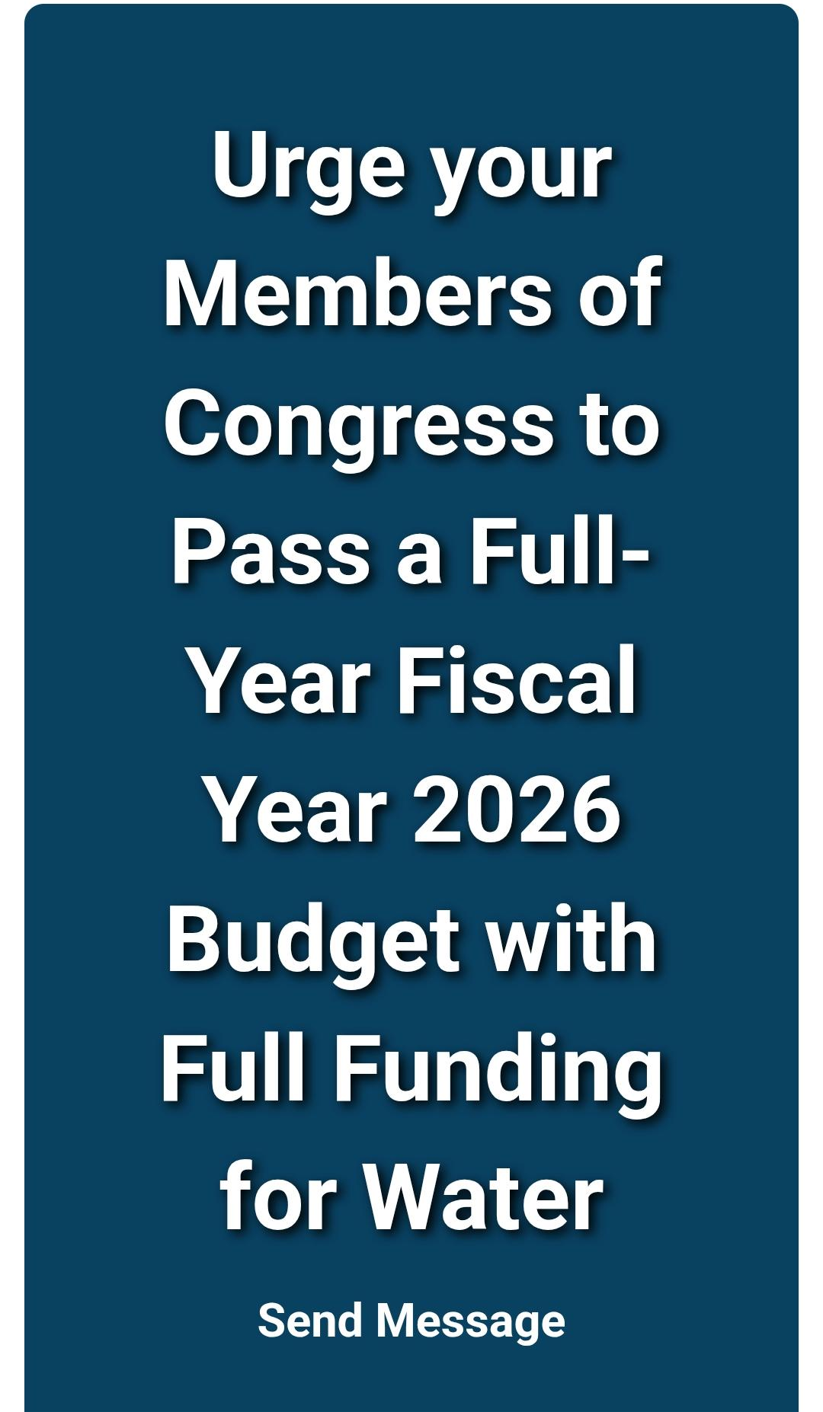
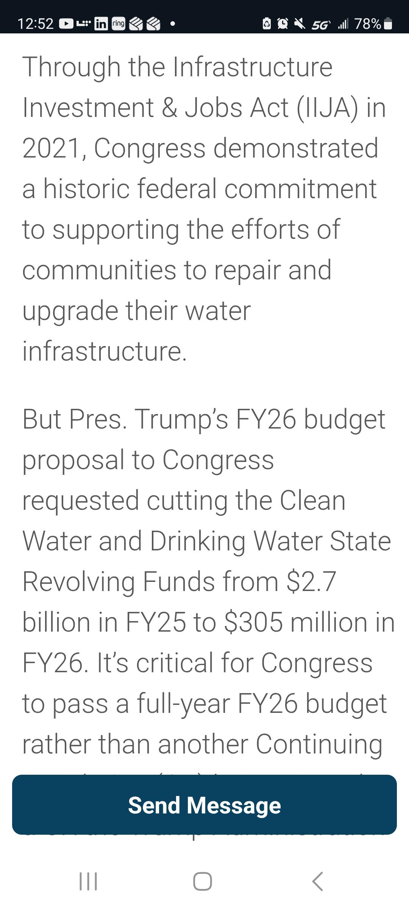
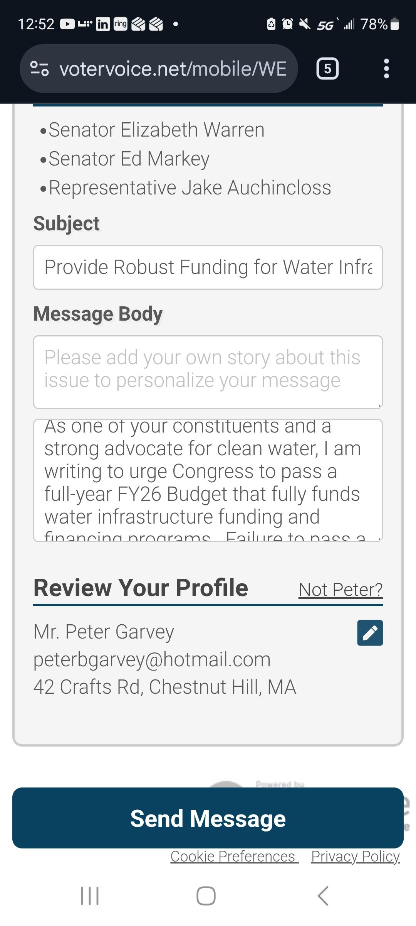
You can add introductory comments
You can edit the letter text
Notes:
Because continued funding is so critical to clean water infrastructure, lets all focus on the 2026 Budget funding request. Select that topic and you will see the content of a letter that is ready to send to your legislator – You should see exactly what is on the screen if you pick the 2026 funding letter
Here is the text of the funding letter that you’ll see…
you can edit the letter as you see fit, but don’t feel compelled to do so – sending as is will be better than waiting to send later!
you can add your comments –
but please make sure to hit ‘Send Message’ at the bottom of the screen,

Slide 10
THANK YOU IF WE DON’T SPEAK UP FOR CLEAN WATER – WHO WILL?
Peter Garvey (WEF Delegate at Large) – pgarvey@BETA-Inc.com
Vanessa McPherson (NEWEA Delegate) - Vanessa.McPherson@arcadis.com
WATER NEEDS YOU!
Notes:
Don’t be concerned that you will start seeing daily emails from WEF on this. You may see something every month or two, as the different topics progress through Congress or as new initiatives are started up. Lets see a show of hands from those who did send a letter today. Thank you all for that, and please continue to engage – if we don’t speak up for Clean Water Who will?
If you want to learn more, or get more involved, reach out to your Govt affairs committee lead [name the person] or reach out to Peter Garvey WEF Delegate at Large Currently representing the program (pgarvey@beta-inc.com) or Vanessa McPherson (Vanessa.McPherson@arcadis.com) NEWEA Delegate to WEF.

