Slide 1
CII Water Audit Jeopardy Rules
You will be assigned to a Team.
When it is your Team’s turn:
Contestants will TYPE Category and Level into chat box.
Host will use 1st response in chat box.
Host will read question.
Any Team member can TYPE “Ready to Answer” in chat box. 1st person to respond will unmute and provide answer to whole group.
If the answer is incorrect, the next Team can answer.

Slide 2
DEFINITIONS
CALCS
TECH
MECHANICAL
OPERATIONAL
100
100
100
100
100
200
200
200
200
200
300
300
300
300
300
400
400
400
400
400
500
500
500
500
500

Slide 3
Define a lavatory faucet.
Used only in a restroom
Used only for hygiene
NOT: janitor, make-­up, kitchen, hand, laundry, clinical, locker room, or bar sink

Slide 4
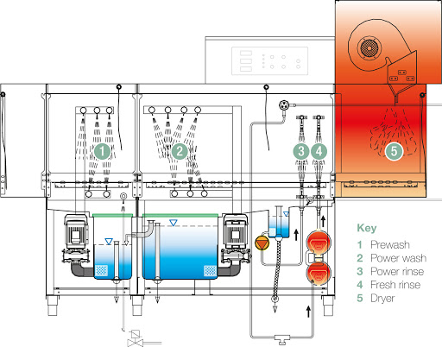
Identify this dishwasher style.
Answer: Rack Conveyor
http://www.maidaid.co.uk/AX-Flight-Machine.html

Slide 5
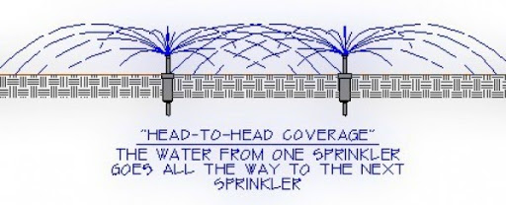
What is head-to-head coverage? Why is it important?
http://www.lawnsprinklerservices.net/pages/services/
Answer: Without head-to-head coverage, turf can develop brown areas where water isn’t reaching. People often overcome this by increasing watering time, which results in waste as too much is then applied to other areas.

Slide 6
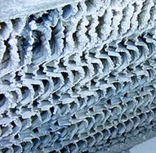
What is scale?
How does it impact a cooling tower?
Answer: Scale is caused when minerals precipitate on cooling tower surfaces. This can interfere with heat transfer, restrict water flow, and cause loss of process efficiency and production.

Slide 7
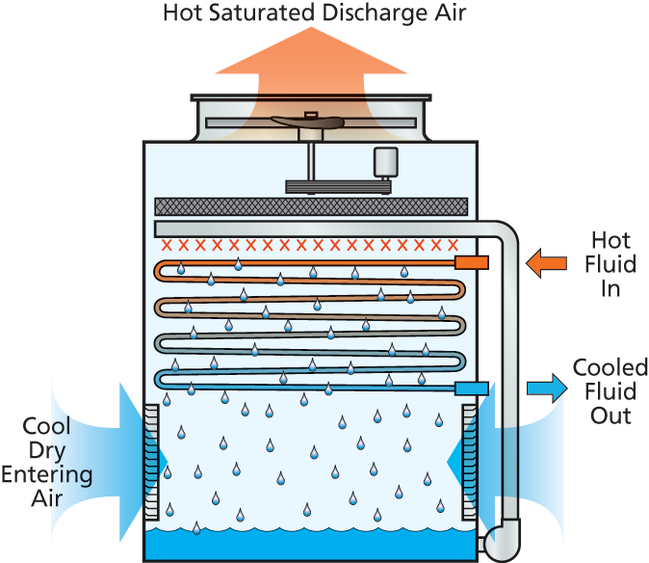
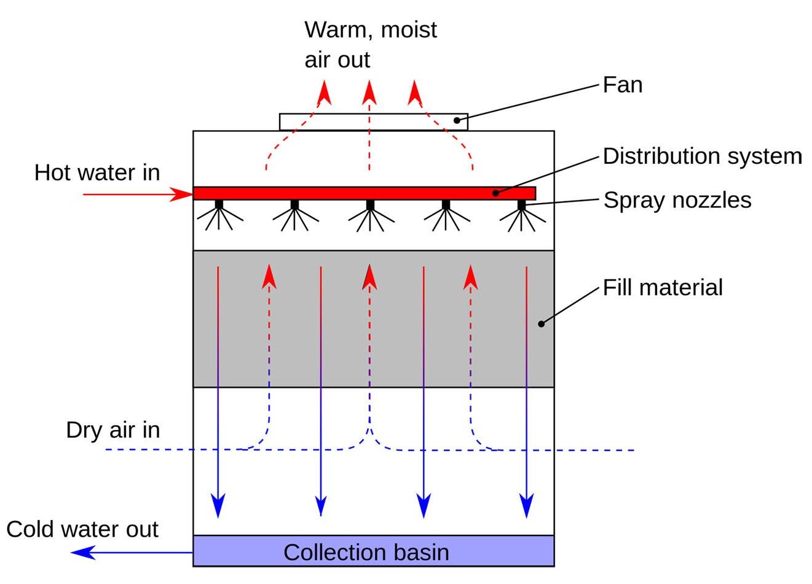
An open-loop cooling tower is used to cool water by direct contact between cooling water and a stream of air.
In a closed-loop cooling tower, the cooling liquid never makes direct contact with the air.
What is the difference between a cooling tower and an evaporative condenser?
Open-Loop Cooling Tower
Closed-Loop Cooling Tower

Slide 8
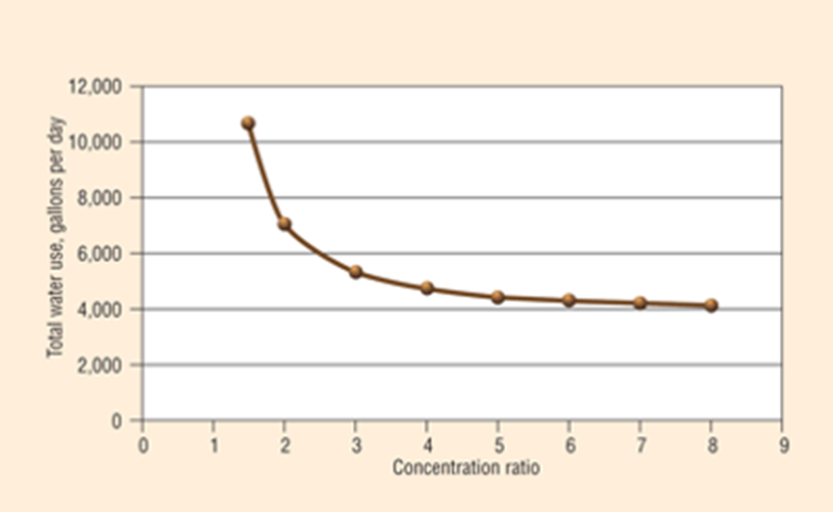
Calculate the COC:
MU=346 ppm BD = 857 ppm
What is your recommendation?
Answer:
COC=BD/MU = 857/346= 2.48

Slide 9
Estimate the gpf from a flushometer valve toilet with a flush time of 8 seconds.
Answer:
~Flush volume in gal.= (flush time in seconds-1)/2
~Flush volume in gal.= (8-1)/2
~Flush volume in gal.= (7)/2 = 3.5 gpf

Slide 10
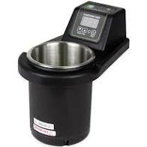
During an audit, you recommend replacing a continuous-flow dipper well with a batch flow ConserveWell. Calculate payback based on the following information:
Answer:~7 months
Existing DW= 0.7 gpm x 660 min/day x 345 days/yr=159,390 gal/yr
ConserveWell= 600 gal/yr
Water savings = 159,390 gal/yr– 600 gal/yr = 158,790 gal/yr
Current Dipper Well Use: 0.7 gpm, 7 days/week, 11 hrs/day, 345 days/year
Cost of Water: $2.45/kgal
Cost of Sewer: $2.00/kgal
Cost of ConserveWell: $407.00
ConserveWell Water Use: 600 gal/year
Cost = purchase of ConserveWell = $407
Retail Cost of Water = $2.45/1,000 gallons
Retail Cost of Wastewater = $2.00/1,000 gallons
Avoided Costs for Customer = $4.45/1,000 gallons
Payback = Cost /Avoided Costs
= $407/(158,790 gal/yr x $4.45/1,000 gallons)
= $407/706.62 = 0.58 years = 6.9 months

Slide 11
What information do you need to create a landscape water budget?
Answer:
ETo = Reference ET = local evapotranspiration rate established by weather data
Kc = Crop Coefficient = percentage of ET that vegetation uses
Area = area of landscape by plant type
$$\frac{ETo (in)}{12 in}×Kc \left(\%\right)×\frac{{area (ft}^{2})}{100} ×.748 \frac{kgal}{{ft}^{3}}=water need (kgal)$$
$$plant water need \left(kgal\right)+turf water need \left(kgal\right)=water budget$$

Slide 12
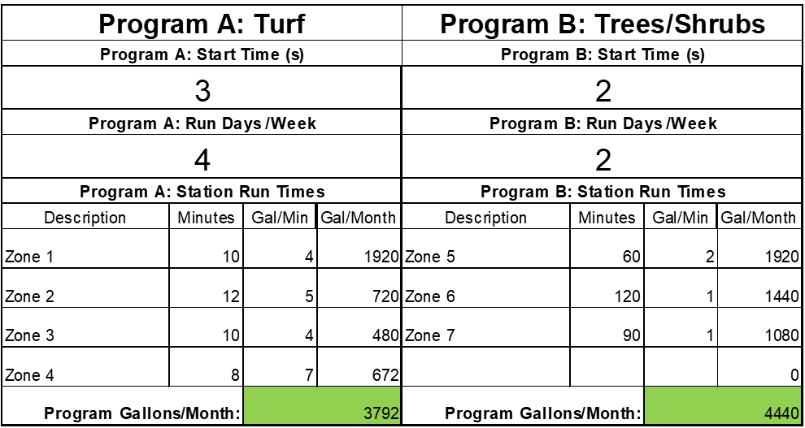
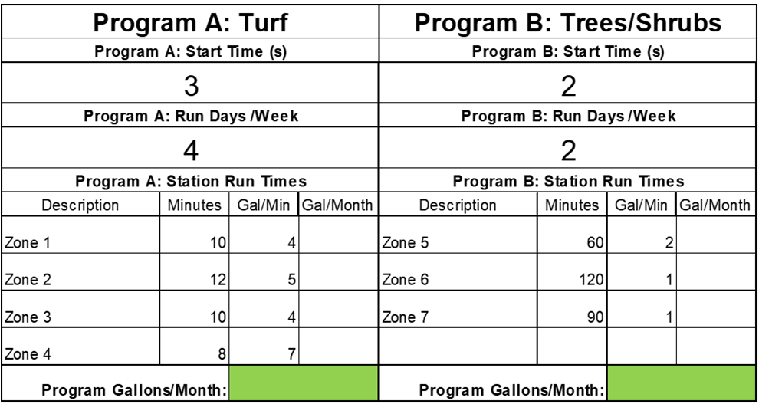
Based on this schedule, estimate the irrigation water use in gal/month.
Answer: 3792 + 4440 = 8,232 gal/month

Slide 13
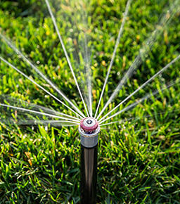
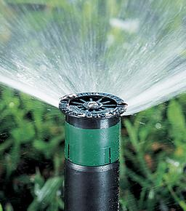
What is the difference between an MP rotator and a spray nozzle? Which do you recommend?
Answer: Spray heads have a constant stream of water and rotary heads rotate over the area they are watering.
https://www.hunterindustries.com/product-line/nozzles
Notes:
MP Rotators apply water at a rate of about ¼ of the rate of traditional spray nozzles of comparable radius. This helps in the efficiency area as MP Rotators apply water at a slower rate—a rate at which soil can better absorb the application of water. since a low precipitation rate is required for most soil types, these longer run times are required for MP Rotators with their low precipitation rates, to let them apply enough water. Spray nozzles put down water at a rate faster than soils can absorb leading to runoff and water waste. When you design a new system with MP Rotators, each zone can cover more area because the lower flow rate through each sprinkler allows you to have more heads on a zone. This makes for fewer zones, and most often allows you the same amount of total watering time when compared to spray systems with many more zones.

Slide 14
Identify 2 potential consequences of installing low-flow fixtures?
Answers:
Water can remain in pipes longer which leads to the decay of disinfectant residuals, potentially resulting in unintended consequences such as waterborne disease.
Many professionals in the efficiency industry are concerned that with less water used, it’s not enough to push waste completely through the drain line.
Public infrastructures (i.e., wastewater conveyance systems) have seen issues with reduced flow rates.

Slide 15
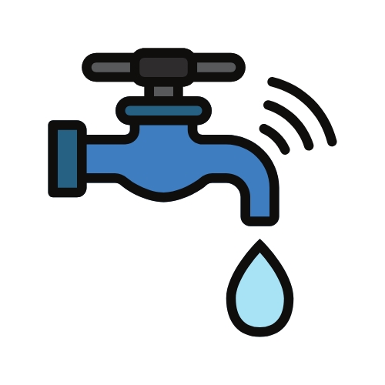
What does IoT mean?
How does it impact Water Management?
Answer:
Internet of Things: the interconnection via the Internet of computing devices embedded in everyday objects, enabling them to send and receive data.
Water Management: Real time monitoring and analytics will increase efficiency, operations, decision making, etc., across the entire urban water cycle.
Notes:
Smart Irrigation- This problem of water wastage can be tackled with the use of IoT. IoT sensors can determine the weather condition and the soil moisture which will help in getting the right amount of water at appropriate time to the desired place.
Waste Water Management- The biggest challenge in water management is to monitor water levels, leakages, water quality and the flow of water through different channels. IoT can come to our rescue in all these areas. Sensors installed at various places in the water system can detect the temperature changes, water leakage, chemical leakage, and pressure level in it. These sensors will then collect the information and send it to the main server. This will ensure that the service engineers solve the issues quickly. Another advantage of IoT in water (waste water management) is that it can detect and calculate the amount of chemical residue present in the water.
Water Quality Testing and Analysis- The internet of things can be used for measuring and monitoring the data captured and drawing real-time analysis of water testing in industries like manufacturing, energy etc. IoT can also be used for public utility companies in the field. The readings are provided to the end users with the help of water testing meters and sensor devices. The end user can get information like Total Dissolved Solids (TDS), Bacteria, Chlorine, Electrical conductivity, etc. This will help in accessing the real-time, accurate quantification of results and will also provide the ability to pinpoint the problem areas.

Slide 16
Describe the mechanical difference between air-cooled vs water- cooled ice machines.
Identify the pros and cons of each.
Answers:
Air-Cooled Ice Machines
Operation: Use air to transfer heat out of the machine. Internal fans and vents inside the machine circulate the air. When air flows through the condenser coils, it removes the internal heat, which is then let out through vents in the rear or sides of the ice machine.
Pros: cheaper, more water/energy efficient
Cons: dirty fan and coils reduce heat transfer
Best: clean, temperature-controlled environments
Water Cooled Ice Machines
Operation: Use water to transfer heat out of the machine. Water runs along the condenser coils and collects heat. The hot water drains out of the unit, removing heat from the system and allowing it to maintain a cool temperature.
Pros: Doesn’t depend on the ambient air temp
Cons: water consumption
Best: where it is difficult to control the temperature; with recirculating water system having a cooling tower to reuse cooling water

Slide 17
A pot sink doesn’t have an aerator installed and has a steady leak. What is your recommendation?
Answer:
Repair the leak.
Would not recommend installing an aerator on a pot sink since the goal of a pot sink is to fill pots quickly.

Slide 18
According to the 2018 Uniform Plumbing Code, metered faucets should deliver a maximum of how many gallons per cycle?
Answer:
0.25 gal (1 liter)

Slide 19
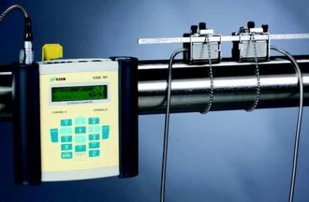
What meter can be installed for temporary flow measurement? How does it work?
Answer: Clamp On Ultrasonic Flow Meter

Slide 20
The meter indicates there is a small leak in a large irrigation system. What do you recommend doing to find the leak?
Answers:
Turn of the irrigation for several days then walk the landscape to look for wet areas.
With the irrigation turned off, open each valve box to look for water and listen for any flow through the valve. It may be helpful to use an irrigation stethoscope to listen to valves. Manually turn each valve on and off and listen/look for any changes.

Slide 21
Using the image below, explain to a customer how weather-based irrigation controllers work.
Answer:
Image courtesy of Town of Gilbert Water Conservation

Slide 22
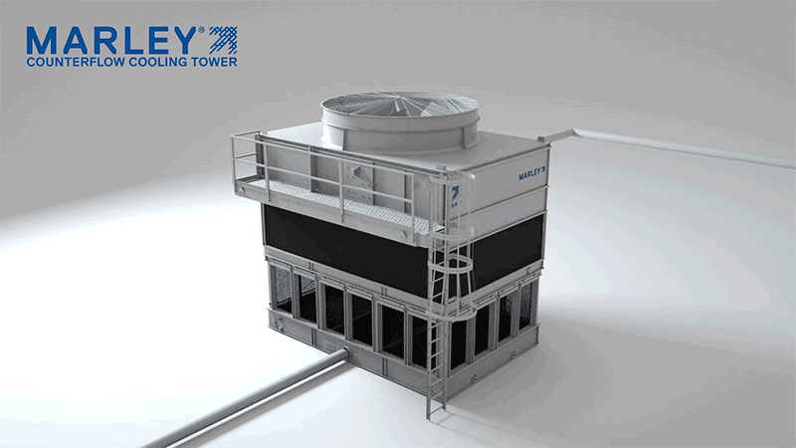
Is this a crossflow or counterflow cooling tower?
Answer: counterflow
Source: https://spxcooling.com/coolingtowers/

Slide 23
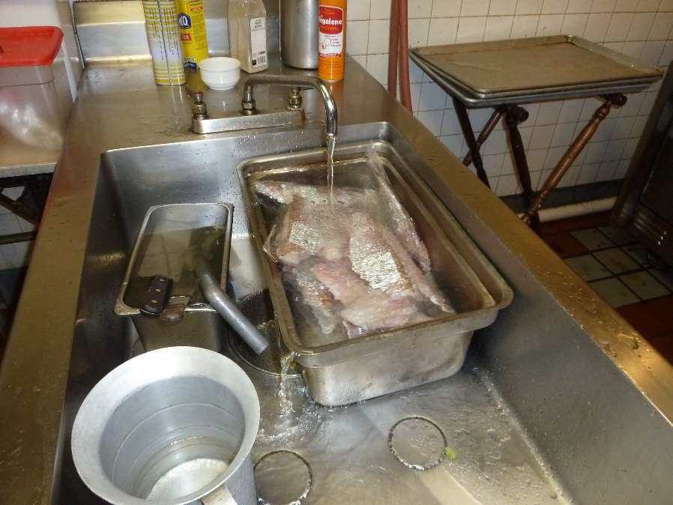
What is the recommended food defrost technique? Why?
Answer: Recommend to defrost ahead of time to avoid water waste. If not possible, recommend to soak (if in compliance with health code).

Slide 24
Describe the benefit of water efficiency beyond just water savings.
Answers:
Reduces peak flows to wastewater treatments.
Reduces peak demand at water treatment.
Reduces size and delays timing of new infrastructure.
The cost of water will always increase but conservation keeps it less expensive.
Prevents damage to infrastructure.

Slide 25
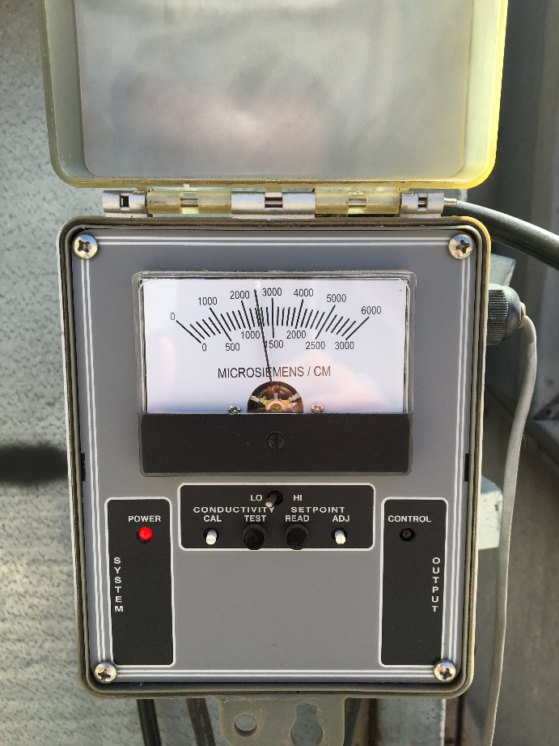
Describe how to initiate a blowdown cycle on the controller pictured below:
Press and hold “test” button.

Slide 26
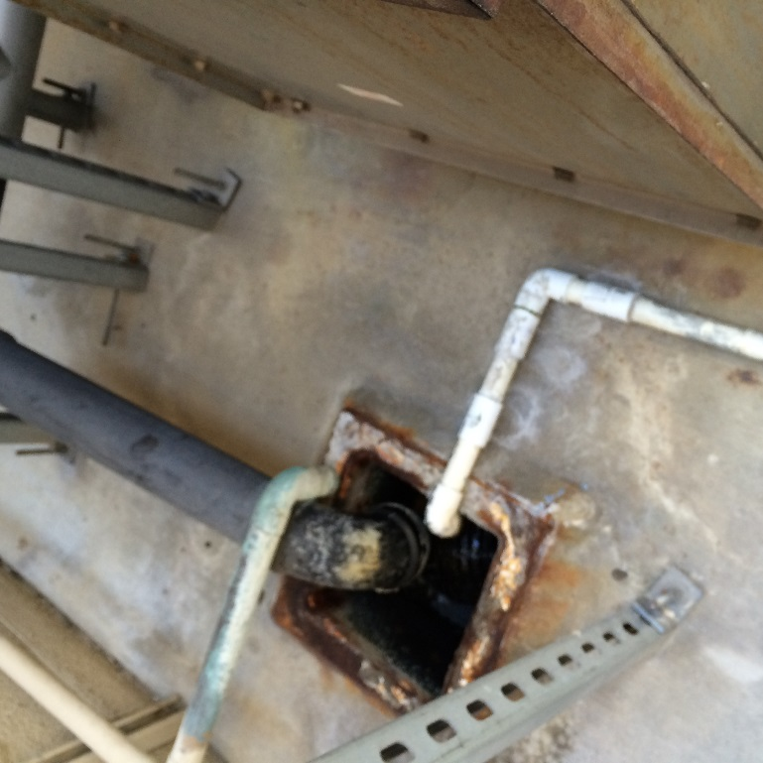
If you see constant flow into the drain from the black pipe, what are two possible causes?
Answer:
Flow from the black pipe would be overflow from inside the basin. Reasons for this could include:
Stuck float valve
Water level set too high (seasonal adjustment)

Slide 27
Share something positive that has resulted from working from home.

