Slide 1
Instructions: How to run game
This version is the traditional Jeopardy style where answer appears first and contestant must provide question: “What is…?”
Game Board –
  To Play: In Presentation Mode, click on blue circles in the lower left to go to question slide.
  To Edit: In Edit Mode, right click to on blue circles to view/edit link to specific slide.
Slides –
  To Play: In Presentation Mode, click anywhere to advance the answer and click on orange circle in lower right to return to main board.
  To Edit: In Edit Mode, adjust animation order to adjust order of appearance and right click on orange circle to edit link.

Slide 2
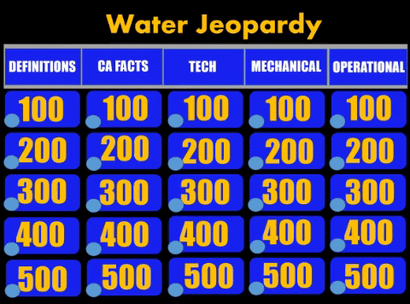
Instructions: How to run game
(go to presentation view for gif to run)

Slide 3
Jeopardy
(category 1)
(category 2)
(category 3)
(category 4)
(category 5)
100
100
100
100
100
200
200
200
200
200
300
300
300
300
300
400
400
400
400
400
500
500
500
500
500

Slide 4
What is ?
(add answer here)
Category 1, $100)

Slide 5
What is ?
(add answer here)
Category 1, $ 200)

Slide 6
What is ?
(add answer here)
Category 1, $300)

Slide 7
What is ?
(add answer here)
Category 1, $400)

Slide 8
What is ?
(add answer here)
Category 1, $500)

Slide 9
(add question here)
(add answer here)
Category 2, $100)

Slide 10
What is ?
(add answer here)
Category 2, $ 200)

Slide 11
What is ?
(add answer here)
Category 2, $300)

Slide 12
What is ?
(add answer here)
Category 2, $400)

Slide 13
What is ?
(add answer here)
Category 2, $500)

Slide 14
What is ?
(add answer here)
Category 3, $100)

Slide 15
What is ?
(add answer here)
Category 3, $ 200)

Slide 16
What is ?
(add answer here)
Category 3, $300)

Slide 17
What is ?
(add answer here)
Category 3, $400)

Slide 18
What is ?
(add answer here)
Category 3, $500)

Slide 19
What is ?
(add answer here)
Category 4, $100)

Slide 20
What is ?
(add answer here)
Category 4, $ 200)

Slide 21
What is ?
(add answer here)
Category 4, $300)

Slide 22
What is ?
(add answer here)
Category 4, $400)

Slide 23
What is ?
(add answer here)
Category 4, $500)

Slide 24
What is ?
(add answer here)
Category 5, $100)

Slide 25
What is ?
(add answer here)
Category 5, $ 200)

Slide 26
What is ?
(add answer here)
Category 5, $300)

Slide 27
What is ?
(add answer here)
Category 5, $400)

Slide 28
What is ?
(add answer here)
Category 5, $500)

