Slide 1
Instructions: How to run game
This version is not in the traditional Jeopardy style. Instead the question is first. This is a good version for doing calculations.
Game Board –
  To Play: In Presentation Mode, click on blue circles in the lower left to go to question slide.
  To Edit: In Edit Mode, right click to on blue circles to view/edit link to specific slide.
Slides –
  To Play: In Presentation Mode, click anywhere to advance the answer and click on orange circle in lower right to return to main board.
  To Edit: In Edit Mode, adjust animation order to adjust order of appearance and right click on orange circle to edit link.

Slide 2
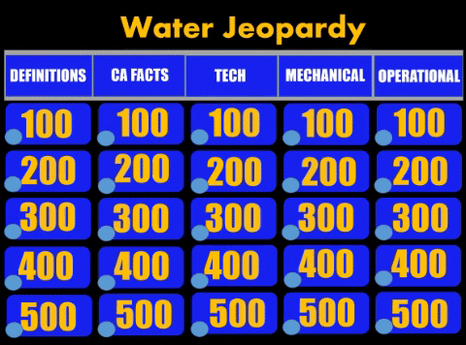
Instructions: How to run game
(go to presentation view for gif to run)

Slide 3
Jeopardy
(category 1)
(category 2)
(category 3)
(category 4)
(category 5)
100
100
100
100
100
200
200
200
200
200
300
300
300
300
300
400
400
400
400
400
500
500
500
500
500

Slide 4
(add question here)
(add answer here)
Category 1, $100)

Slide 5
(add question here)
(add answer here)
Category 1, $ 200)

Slide 6
(add question here)
(add answer here)
Category 1, $300)

Slide 7
(add question here)
(add answer here)
Category 1, $400)

Slide 8
(add question here)
(add answer here)
Category 1, $500)

Slide 9
(add question here)
(add answer here)
Category 2, $100)

Slide 10
(add question here)
(add answer here)
Category 2, $ 200)

Slide 11
(add question here)
(add answer here)
Category 2, $300)

Slide 12
(add question here)
(add answer here)
Category 2, $400)

Slide 13
(add question here)
(add answer here)
Category 2, $500)

Slide 14
(add question here)
(add answer here)
Category 3, $100)

Slide 15
(add question here)
(add answer here)
Category 3, $ 200)

Slide 16
(add question here)
(add answer here)
Category 3, $300)

Slide 17
(add question here)
(add answer here)
Category 3, $400)

Slide 18
(add question here)
(add answer here)
Category 3, $500)

Slide 19
(add question here)
(add answer here)
Category 4, $100)

Slide 20
(add question here)
(add answer here)
Category 4, $ 200)

Slide 21
(add question here)
(add answer here)
Category 4, $300)

Slide 22
(add question here)
(add answer here)
Category 4, $400)

Slide 23
(add question here)
(add answer here)
Category 4, $500)

Slide 24
(add question here)
(add answer here)
Category 5, $100)

Slide 25
(add question here)
(add answer here)
Category 5, $ 200)

Slide 26
(add question here)
(add answer here)
Category 5, $300)

Slide 27
(add question here)
(add answer here)
Category 5, $400)

Slide 28
(add question here)
(add answer here)
Category 5, $500)

