Slide 1
New York Water Environment Association, Inc. 2018 Awards
February 6, 2019

Slide 2
Water Environment Federation Awards

Slide 3
WEF Quarter Century Operators Club
An informal group of active members of the Federation who have been engaged in wastewater treatment plant operation for at least 25 years.

Slide 4
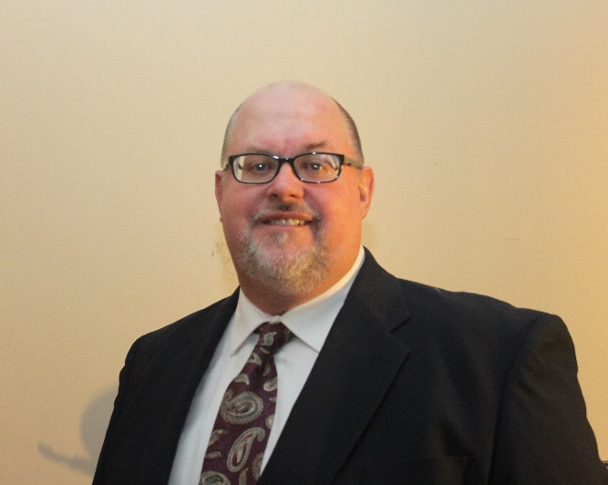
WEF Quarter Century Operators Club
Jeffrey P. Sikora
A.S. from Cayuga Community College and B.S. from SUNY Oswego
NYSDEC Grade 4 and 4A certification
Has worked for City of Auburn since 1990
Chief Operator of Auburn WWTP since 2010

Slide 5
Life Membership
Awarded to an individual who has been an active member of one or more Member Associations for a total of at least 35 years and has attained the age of 65.
Notes:
Seven this year

Slide 6
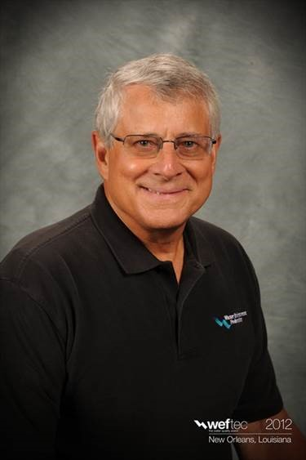
WEF Life Membership
Robert (Bob) Adamski
Licensed Professional Engineer in and Board Certified Environmental Engineer
Grade 4A Operator
Held many positions at NYC DEP
Served on NYWEA and WEF Public Education Committee, NYWEA Board of Directors, WEF Delegate
Currently serves as interim chair of NYWEA Humanitarian Assistance Committee

Slide 7
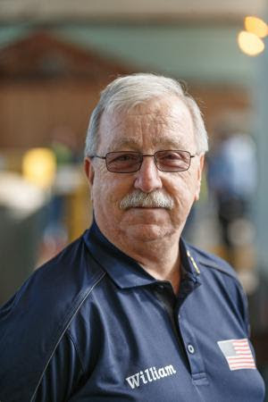
WEF Life Membership
William (Bill) Gardner
Worked at NYC DEP from 1978 – 2010
NYWEA Member since 1978
NYWEA Hall of Fame member
Active member of Met Operations Challenge Committee since 1985
Currently serves Utility O&M Committee, Conference Management Committee, Training Task Force
Chief Operator of Society of Sanitary Sludge/Shovelers

Slide 8
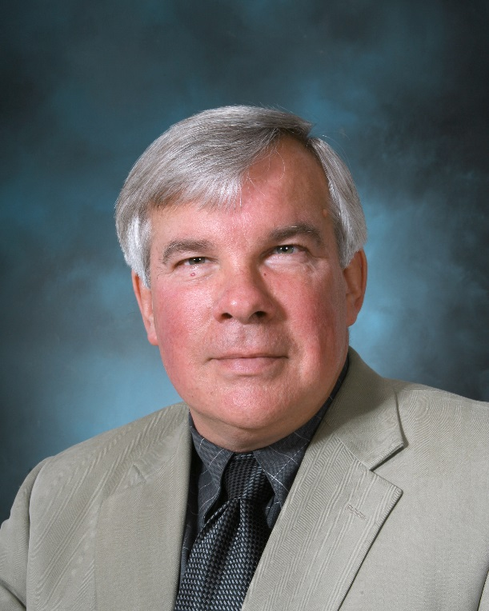
WEF Life Membership
Gerald (Jerry) Hook
Member of WEF and NYWEA Central Chapter since 1976
Chair of NYWEA Program Committee for 10 years
Served on WEF’s Residuals and Biosolids Committee
Chair of WEF Program Committee

Slide 9
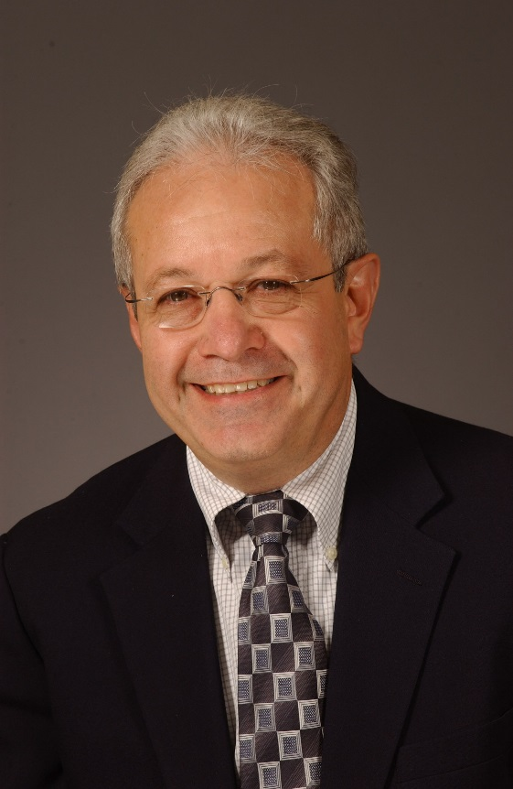
WEF Life Membership
Alfonso (Al) Lopez
Licensed Professional Engineer and NYS Grade 4A WWTP Operator
Active member of WEF since 1983
Served Met Chapter Chapter Chair, Chair/Co-chair of Scholarship Committee since inception, and WERF Board of Directors
Served a NYC DEP Deputy Commissioner of Bureau of Engineering, Design, and Construction (BEDC)

Slide 10
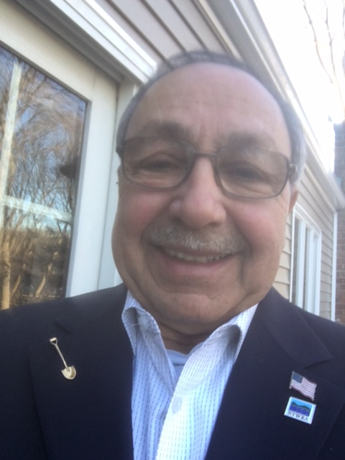
WEF Life Membership
Maurice Osman
More than 55 years experience in wastewater treatment
Retired from Nassau DPW
25 years as instructor for operator-related water and wastewater treatment course
Member of Long Island Chapter and was active with the Board for many years
NYWEA member since 1968

Slide 11
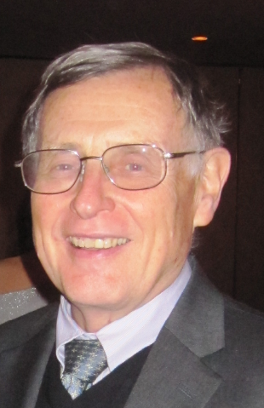
WEF Life Membership
William (Bill) Pfrang
More than 40 years experience
Contributing author for 5th Edition of AECOM/Metcalf & Eddy textbook titled Wastewater Engineering – Treatment and Resource Recovery
Vice-President and Wastewater Treatment Technology Leader for AECOM’s NY Metro Water Group

Slide 12
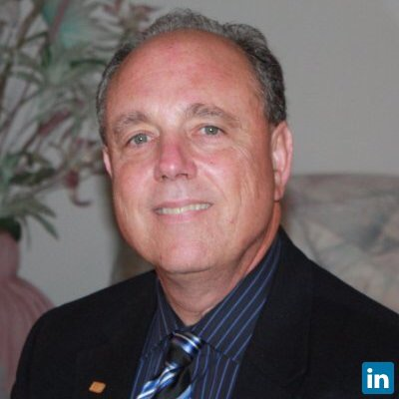
WEF Life Membership
Elliot F. Sachs
NYWEA member since 1978
Past Met Chapter Chairman, NYS Board of Directors, WEF Board of Control
Active member of the Program Committee from 1980 to present, was Co-chair for 3 years
Project Manager at Boswell Engineering

Slide 13
WEF Board of Directors Award
Recognizes individuals who have served on the Federation Board of Directors.

Slide 14
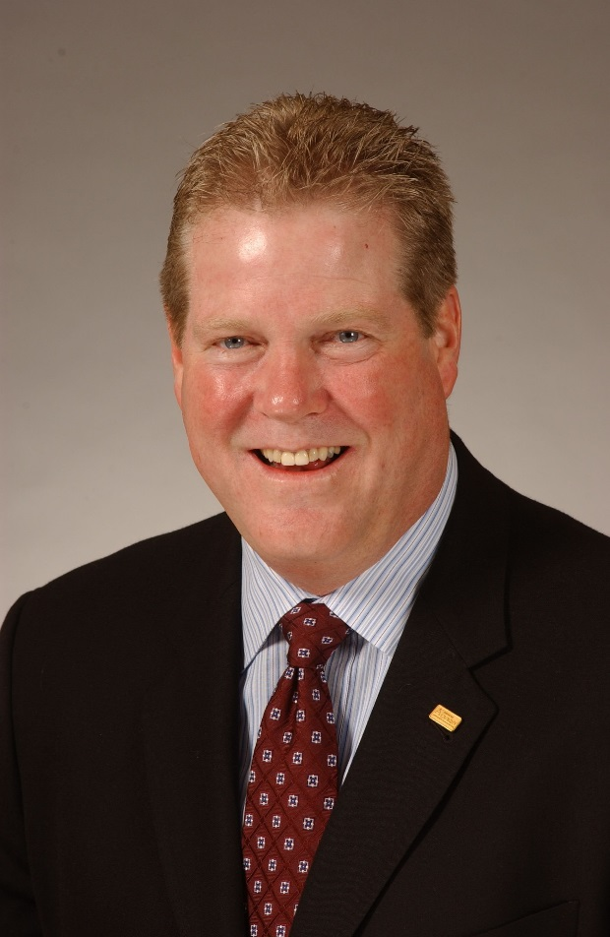
WEF Board of Directors Award
Richard Pope
Three decades of NYWEA service
Public Outreach Committee since 1999
Program Committee since 2002
Founding member of PDH Review Committee
WEF house of Delegates and Technical Practice Committee
Active member of WEF Air & Odor Control for over 25 years

Slide 15
Arthur Sidney Bedell Award
Awarded to an individual who has provided extraordinary personal service to the Member Association.

Slide 16
Arthur Sidney Bedell
Richard Pope
Three decades of NYWEA service
Public Outreach Committee since 1999
Program Committee since 2002
Founding member of PDH Review Committee
WEF house of Delegates and Technical Practice Committee
Active member of WEF Air & Odor Control for over 25 years

Slide 17
Laboratory Analyst Excellence Award
Recognizes individuals for outstanding performance, professionalism, and contributions to the water quality analysis profession

Slide 18
Laboratory Analyst Excellence Award
Stephan Bland
Environmental Chemist at Monroe County at the Frank E. Van Lare Water Resource Recovery Facility (FEV) since 2000
Played an instrumental role in pilot testing being used for full scale aeration system upgrade
Tour guide at FEV annual open house
Trains prospective operators for lab proficiency exam needed for NYS Wastewater Operator Certification

Slide 19
New York Water Environment Association Awards

Slide 20
New York Water Environment Association Elected Officials Awards

Slide 21
Nelson A. Rockefeller Award
Awarded to an elected official at a City (population over 250,000), State or National level who has made a substantial and meaningful contribution to advancing effective environmental programs.

Slide 22
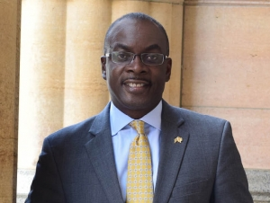
Nelson A. Rockefeller Award
Honorable Byron Brown, Mayor
Mayor of Buffalo, NY
Partnered with Buffalo Sewer Authority (BSA) to launch Rain Check Buffalo, a program to address stormwater challenges
Committed to reducing CSOs through BSA’s LTCP and $92 million investment in green infrastructure
Increased frequency of City of Buffalo’s lead testing in drinking water

Slide 23
Frank E. Van Lare Award
Awarded to an elected official at a local level, assembly or higher, who has made a substantial and meaningful contribution to advancing effective water quality management.

Slide 24
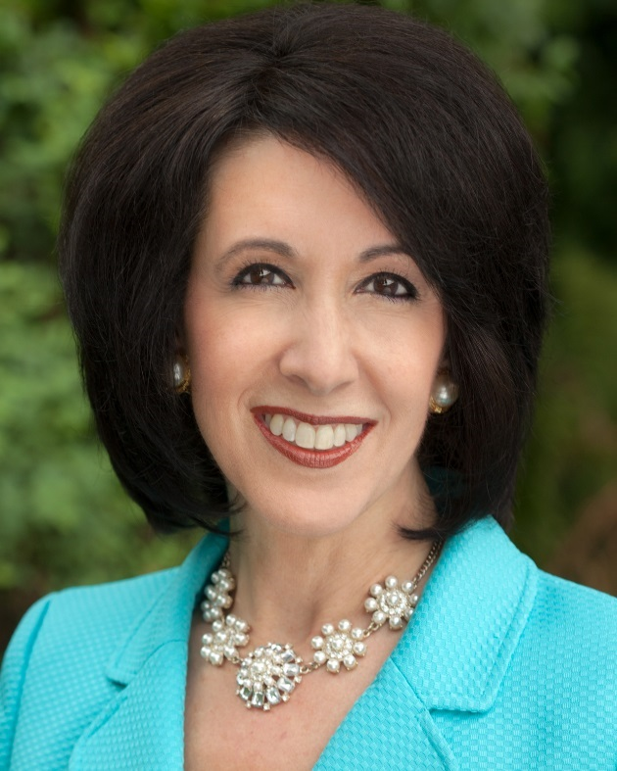
Frank E. Van Lare Award
Cheryl Dinolfo
Monroe County Executive since 2016
Prioritized investment to help sustain a clean, reliable, compliant, and affordable water environment
Focus on Frank E. Van Lare Resource Recovery Facility led to improvements in plant performance, compliance, and reduced vacancies of qualifies staff
Led the County to increase Operator wages, support state certification and professional training

Slide 25
New York Water Environment Association Technical Papers

Slide 26
The Kenneth Allen Memorial Award
This award is presented annually for a paper describing work of a research or engineering nature.

Slide 27
Kenneth Allen Memorial Award
Nicholas Bartek
Environmental Engineer at Brown & Caldwell’s NYC Office
Specializes in municipal wastewater treatment, particularly anaerobic digestion and biosolids
Received award for “Understanding the Role of Mixing and Rheology in Rapid Volume Expansion Due to Gas Holdup in Anaerobic Digesters”

Slide 28
Linn H. Enslow Memorial Award
This award is presented annually for an outstanding paper presented at the Association’s Annual Meeting or published in a professionally recognized technical journal by a person or persons, not members of NYWEA.

Slide 29
Linn H. Enslow Memorial Award
Chris Nativsky
Lake George Waterkeeper for over 15 years
Licensed Professional Engineer
2005 Conservationist of the Year by the Adirondack Counsel
Featured in Adirondack Life and Adirondack Explorer
Received Award for “Algal Biomonitoring Documenting Water Quality Impacts on Lake George”

Slide 30
Charles Agar Memorial Award
This award is presented annually for a paper concerning wastewater management which is not of a research and engineering nature, but rather deals with public education or general water quality programs and activities

Slide 31
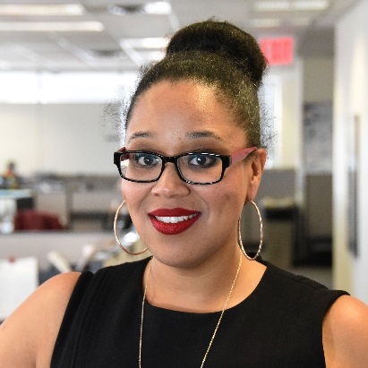
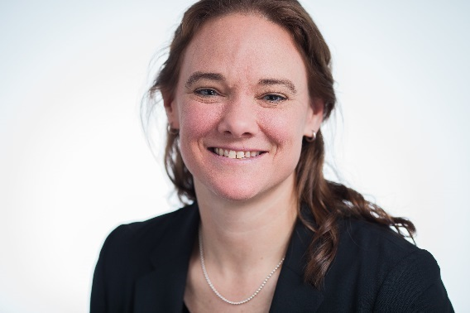
Charles Agar Award
Mikelle Adgate and Aimee Boulet
Senior Advisor within NYCDEP’s Bureau of Public Affairs & Communication
Supports Deputy Commissioner and oversees the Legislative Affairs, Marketing, and Special Projects Teams
Project Manager with AECOM New York Water Metro Division
Currently serves as Program Manager for NYC’s Combined Sewer Overflow Program and Design Manager for NYC’s WWTP Resiliency Program
Received Award for “The CSO Long Term Control Plan Public Outreach Initiative”

Slide 32
Lewis Van Carpenter Award
This award is presented annually to PWO members for a paper describing work in the field of sewage or waste treatment

Slide 33
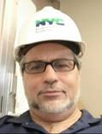
Lewis Van Carpenter Award
Peter Pianelli and Antonio Ho
Started with NYC DEP in 1990
Facility Manager at Hunts Point and Oakwood Beach WPCPs
Process Engineer at Hunts Point and Tallman Island WWTP
Current focus is on whole plant optimization, innovative resource recovery, and nutrient removal
Received Award for “Magnesium Hydroxide Addition to SCT Reactor at Hunts Point WPCP”

Slide 34
New York Water Environment Association Environmental Science & Management Awards

Slide 35
Emmaline Moore Award
Awarded to an Association Member who has made a significant impact in the area of water quality management, and/or water and sewer infrastructure development, and is also a municipal/government employee in the state of New York

Slide 36
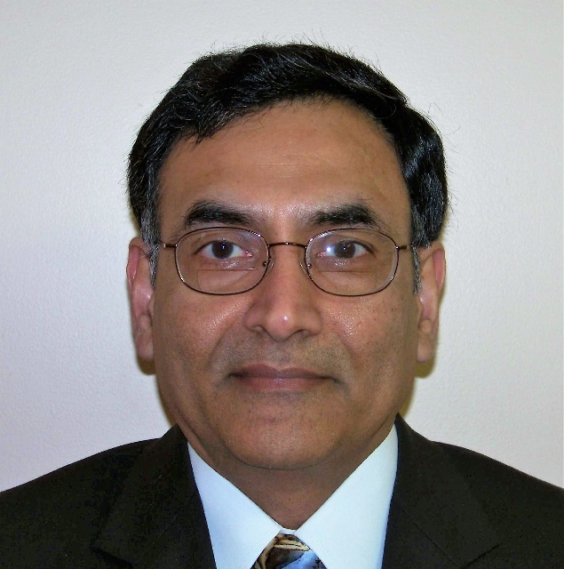
Emaline Moore Award
Pradeep Jangbari
With NYSDEC for over 35 years
Compliance coordinator for Division of Water (Region 8 office)
Member of Association and Award Committee
Local Industrial Issues Committee

Slide 37
Environmental Engineer Award
Awarded to an Association Member working in consulting or government who has made a significant impact in the area of environmental engineering and management

Slide 38
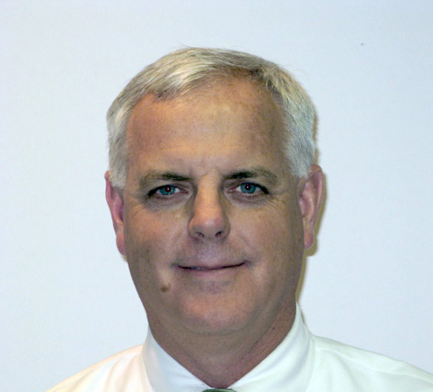
Environmental Engineer Award
Keith F. Kelly
Professional Engineer in NY
Over 38 years experience in all aspects of environmental engineering
Has successfully managed numerous projects including design-build and $100 million plus programs in the tri-state area

Slide 39
New York Water Environment Association Wastewater Facility Operations Awards

Slide 40
Uhl T. Mann Award
This award commemorates the career and long time service of Uhl T. Mann to the Association. He was Superintendent of an Onondaga County Plant for 25 years and then Commissioner of Onondaga County Department of Drainage and Sanitation. He served as NYWEA President in 1976, and was secretary to the Central Chapter for 29 years.
This award is given annually by the Association for excellence in treatment plant operations and maintenance.

Slide 41
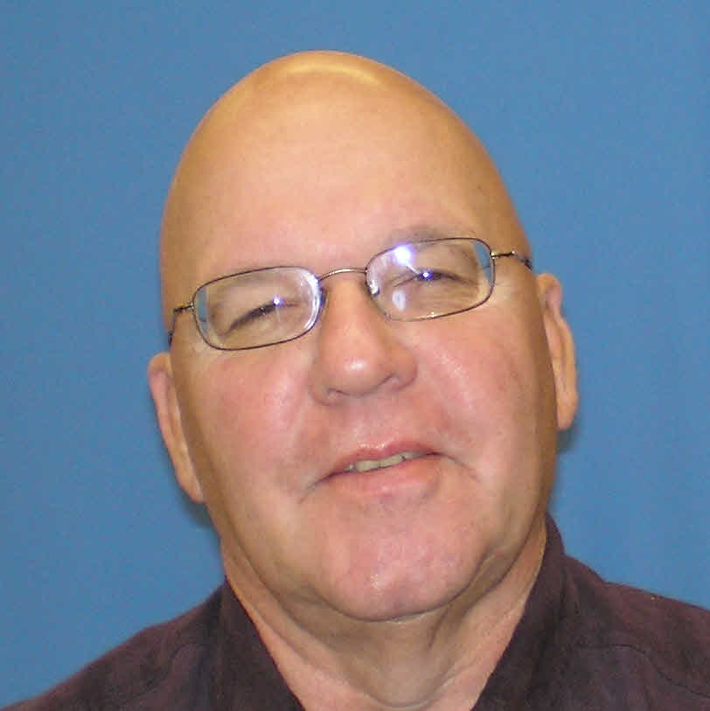
Uhl T. Mann Award (Operations 10.1 – 80 MGD)
Glenn Absolom
Grade 4A certified operator
Certified Wastewater Collections Operator
48 years experience in all aspects of wastewater treatment
Responsible for all phases of field operations for Erie County’s Division of Sewerage Management
Responsible for six WRRFs, five ORFs, 100+ pumping stations and over 1,000 miles of sewer lines

Slide 42
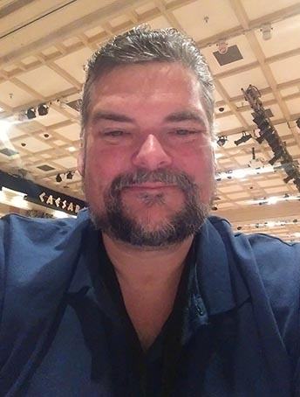
Uhl T. Mann Award (Operations >50 MGD)
Howard Robinson
Grade 4A certified operator
With DEP since 1988
Chief Operator of Coney Island WRRF
Currently Met Chapter Operations Chair
Lead Coordinator for Metropolitan NYC DEP Operator’s Challenge Team and Event Coordinator for NY State Operators Challenge

Slide 43
Uhl T. Mann Award (Maintenance >50 MGD)
William Schroder
Grade 4A certified operator
With DEP since 1994
Plant Chief of Port Richmond WRRF
Has served at Coney Island, Bowery Bay, North River, Oakwood Beach, Collections Facility North, Manhattan Pumping Station, Newtown Creek, and 26th Ward WRRFs.

Slide 44
Milton T. Hill Award
Awarded for outstanding contributions to the cause of improving the status of water pollution control personnel and enhancing the status of operators through training and education

Slide 45
Milton T. Hill Award
Joseph Atkins
Member of Met Chapter Operations Challenge Team from 1998-2004
NYWEA Operations Challenge Collection Even Coordinator from 2005-present
Trains and mentored every team that has competed at the chapter and state level
Developed guidelines used in the collections event

Slide 46
Collection System Operator Award
This award is given to an individual in recognition of their outstanding contributions to the evaluation, rehabilitation, design, or construction of collection facilities.

Slide 47
Collection System Operator Award
Matthew Roberts
NYS Voluntary Collection System Grade 4 Certification
With Suffolk County for 36 years
Highway Zone Supervisor
Implemented a program to fight grease blockages and preventative maintenance cleaning program
Decreased blockages from 60 annually to 10

Slide 48
New York Water Environment Association Membership Recruitment Awards

Slide 49
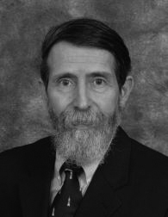
Most New Student Members
Walter Saukin, Ph.D.
Faculty member at Manhattan College for the past 37 years
Chair of the Civil Engineering Department for nine years
Past Executive Secretary of NYWEA and Chair of the Student Committee
Recipient of Arthur Sidney Bedell Award and Metropolitan Chapter’s Award of Merit

Slide 50
New York Water Environment Association Public Education Awards

Slide 51
Public Education Award
This award is given to individuals, companies or local Chapters that have made an outstanding contribution to public education.

Slide 52
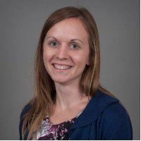
Public Education Award
Megan Messman
Project Manager with CDM Smith
Long Island Chapter Public Education Committee, Chair for last 4 years
Organizes annual Water Conservation Poster Contest for grades 1 through 4
Long Island Chapter Board of Directors

Slide 53
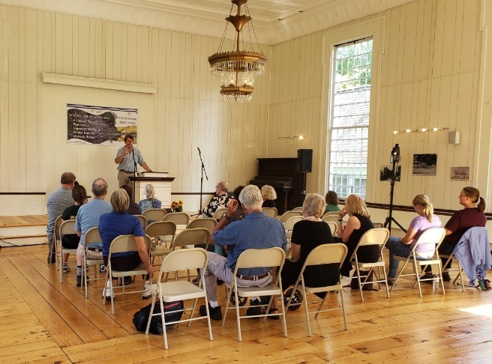
Public Education Award
Schoharie River Center
Community based Science and Arts educational not for profit organization dedicated to promoting environmental consciousness and understanding of ecology of Schoharie Watershed and Mohawk River Basin
Sponsors and operates Environmental Study Team (EST), award winning youth development program
Active in a variety of community, historical, and cultural programs and activities

Slide 54
Water Hero Award
Awarded to any Association Member who has made a consistent, sustained and meaningful contribution to improving water quality through their everyday responsibilities, actions and efforts.

Slide 55
Water Hero Award
Robert (Bob) Adamski
Licensed Professional Engineer in and Board Certified Environmental Engineer
Grade 4A Operator
Held many positions at NYC DEP
Served on NYWEA and WEF Public Education Committee, NYWEA Board of Directors, WEF Delegate
Currently serves as interim chair of NYWEA Humanitarian Assistance Committee

Slide 56
New York Water Environment Association Service Awards

Slide 57
John Chester Brigham Award
Awarded to an individual in recognition of their outstanding service to the Association.

Slide 58
John Chester Brigham Award
Roberta (Robbie) Gaiek
Lead engineer for the Buffalo Sewer Authority’s Capital Improvement Program at their Bird Island WWTP
NYWEA member for over 20 years
Chair of Western Chapter 2007-2012 and 2017-present
Serves on Utility Executive Committee
Chair of Greater Buffalo Environmental Conference Committee for several years

Slide 59
John Chester Brigham Award
Vincent (Vinnie) Rubino
Northeast Area Lead/Vice President for Wade Trim
Experience comprised of strategic planning, project development, and project delivery
Active in NYWEA’s Sustainability and Program Committees and chairs the PDH Subcommittee

Slide 60
Robert M. MacCrea Award
Awarded to a sales representative who has made a significant contribution to the Association.

Slide 61
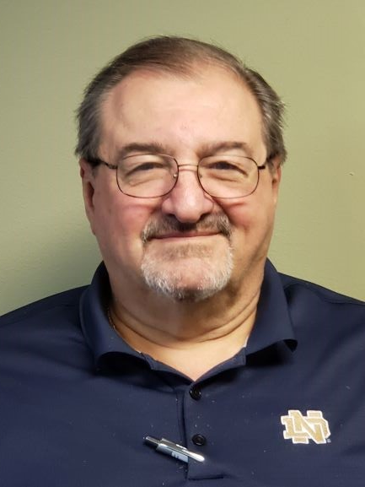
Robert M. MacCrea Award
Anthony (Tony) Coppola
40 years experience in sales, representing manufacturers of water and wastewater equipment
Joined NYWEA Met Chapter in 1974
Has served on various committees including Membership, Awards/Journal, and Program
In 2016 was unanimously voted as Board Chairperson for 2-year term

Slide 62
Young Professionals Service Award
This award acknowledges the involvement of a young professional in the Association. Awarded to an Association member 35 years of age or younger who has shown leadership and involvement in Association activities.

Slide 63
Young Professionals Service Award
Alexander Lopez
Chair of Met Chapter Young Professional Committee from 2016-2017
Licensed Professional Engineer
NYCDEP Bureau of Design and Construction In-House Design Division

Slide 64
Board of Directors Service Award
This award is presented for service as a member of the Board of Directors of the NYWEA.

Slide 65
Board of Directors Service Award
William Davis
Member of Genesee Valley Chapter for 4 years
Served as Vice-Chair, Chair, and State Board Representative
Senior Project Manager/Team Leader and Wastewater Design Specialist at MRB Group since 1999
Notes:
Genesee Chapter

Slide 66
Board of Directors Service Award
George Desmarais
Senior Vice President with H2M Architects and Engineers
Has held the following Long Island Chapter Positions: Membership Committee, Board of Directors, Secretary, Treasurer, Chapter Chair, and State Board Representative
Notes:
LI Chapter

Slide 67
Board of Directors Service Award
Rich Fiedler
37 years experience in water and wastewater process and sales
Serves on Lower Hudson Chapter NYWEA Board of Directors and NYWEA State Board of Directors
Notes:
Lower Hudson Chapter

Slide 68
Board of Directors Service Award
Brian Skidmore
Managing Engineer at Barton and Loguidice, working in the Water and Wastewater group since 1996
Member of NYWEA since 1994
Taken on numerous roles at Chapter and State levels
6-year term on Central Chapter Board of Directors
3 years as Chapter’s Representative on the State Board of Directors
Notes:
Central Chapter

Slide 69
Retiring Committee Service Recognition
This award is automatically granted upon successfully completed leadership term as a committee chair, co-chair or vice-chair.

Slide 70
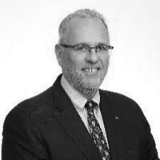
Retiring Committee Service Award
Jeffrey Butler
Program Committee
Senior Project Manager with LiRo Group
Served on Met Chapter Board, Met Chapter Chair, and Chapter Representative to NYWEA
Served on Program Committee for 10 years, concluding his position as Vice-Chair

Slide 71
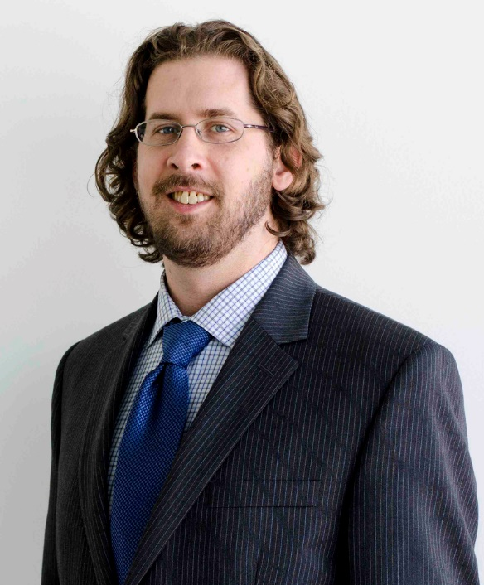
Retiring Committee Service Award
Khristopher Dodson
Public Outreach Committee
Associate Director at Syracuse University Environmental Finance Center
Has Master’s degrees from SUNY College of Environmental Science and Forestry and Syracuse University Newhouse School

Slide 72
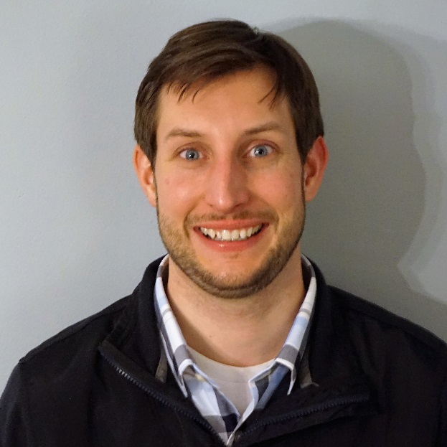
Retiring Committee Service Award
Alexander (Alex) Emmerson
Utility O&M Committee
Shift Superintendent in charge of Process at Buffalo Sewer Authority’s Bird Island WWTP
NYSDEC Grade 4A Operator
Past Co-Chair of Western Chapter’s YP Committee

Slide 73
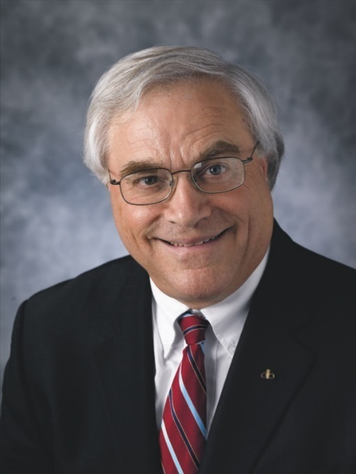
Retiring Committee Service Award
Steven Fangmann
President & CEO of D&B Engineers and Architects
Served on Long Island Chapter Board of Directors, NYWEA Executive Board, NYWEA Vice-President, President, Long Island Chapter President
Presently Ambassador of Water for NYWEA

Slide 74
Retiring Committee Service Award
Vincent (Vinnie) Rubino
Sustainability Committee
Northeast Area Lead/Vice President for Wade Trim
Experience comprised of strategic planning, project development, and project delivery.
Active in NYWEA’s Sustainability and Program Committees and chairs the PDH Subcommittee

Slide 75
Retiring Committee Service Award
Drew Smith
Government Affairs Committee
Worked in water quality for more than 35 years
Served as Laboratory Director and Regulatory Compliance Manager at Monroe County
Board of Directors for Genesee Water Watch

Slide 76
Wastewater Operator Certification Governance Council Award
This award is presented for service as a member of the NYWEA Operator Certification Governance Council

Slide 77
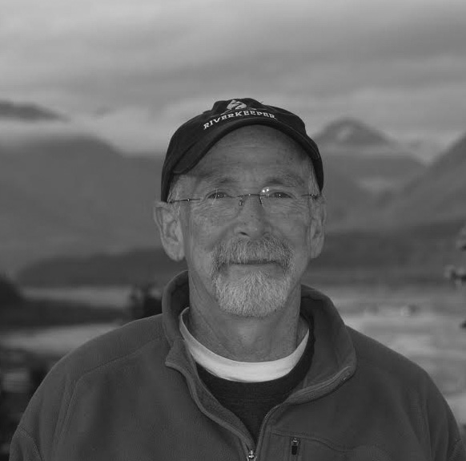
Wastewater Operator Certification Governance Council Award
James Cunningham
President of New Water Technologies
Former Adjunct Professor at SUNY Morrisville
Former Chair of Central Chapter
Awarded by USEPA for outstanding wastewater facility management
Currently serves on NYWEA Member Education Committee and the Operator Certification Governance Council

Slide 78
Outstanding Student Service Award
This award recognizes the involvement of a student member who promotes the New York Water Environment Association on the high school level, student chapter level, professional chapter level, Association or Federation level.

Slide 79
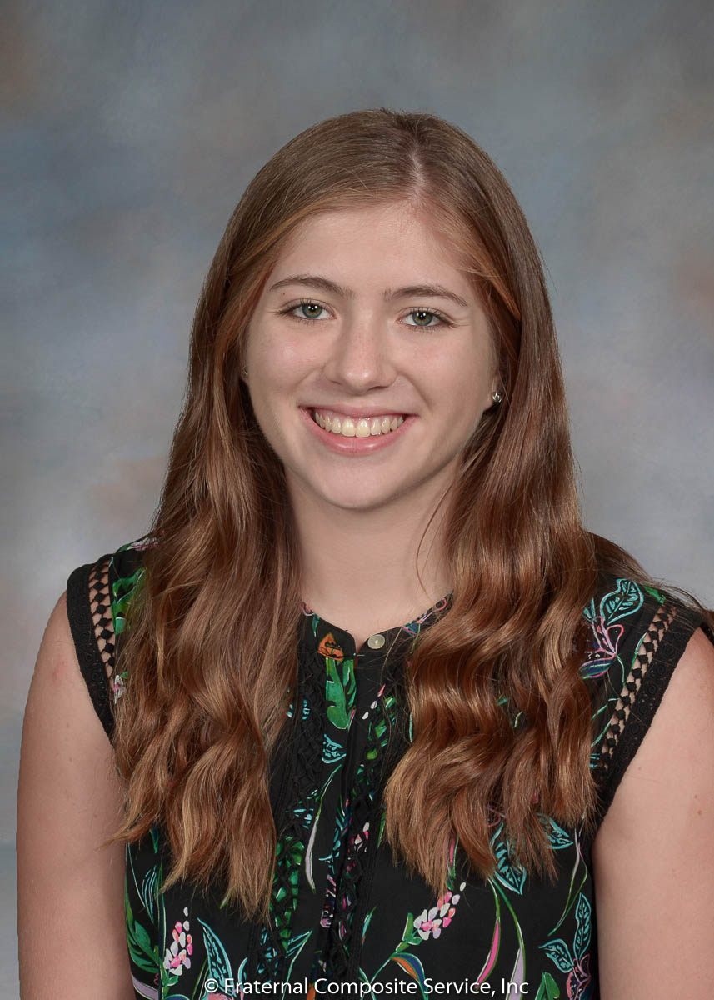
Outstanding Student Service Award
Elena Araya
Undergraduate at SUNY College of Environmental Science and Forestry
President of SUNY ESF Student Chapter
Worked at NYWEA Executive office
Fundraised for and Organized trips to NYWEA Annual Conference and WEFTEC in New Orleans
Organized Chapter Activities
Prepares Chapter’s Annual Newsletter

Slide 80
Association Student Chapter Service Award
This award recognizes the involvement of a student in a NYWEA Student Chapter

Slide 81
Association Student Chapter Service Award
Briana M. Fitzgerald
Undergraduate at SUNY College of Environmental Science and Forestry
Secretary of Student Chapter
Supports Chapter activities including coordinating biweekly event planning as well as coordinating speaker and service projects
Intern at NYWEA Executive Office

Slide 82
Association Student Chapter Service Award
Luiza Molohides
Undergraduate student at City College of New York
Member of NYWEA CCNY Chapter and served as past President and Mentor of the Executive Board
Organized field trips to Newtown Creek WWTP, Five Borough Complex, and Singlecut Beersmith Brewery
Coordinated fundraising events as well as events with other organizations

Slide 83
Student Paper Presentation Award
This award recognizes the winners of the student paper competition
Notes:
Stefan Grimberg or Krish Ramalingam to present

Slide 84
Lucy Grassano Operator Scholarship Recipients
Add names

Slide 85
Long Standing Members
Recognizing individuals who have been NYWEA members for 20 years or longer.
60 YEARS
Robert J. Ganley
50 YEARS
Lawrence Clare
George Kehrberger
Harold Kohlmann
William D. Smith
John Yessis
40 YEARS
Robert Elliot
Martin Enseliet
Krishamurthy Gopala-krishnan
Edwin Kipp
Mark Pritchard
Terence Sharp
Bert Stipe
Benjamin Wright
30 YEARS
Diego Alaimo
John Amend
Timothy Conroy
Anthony Coppola
William Davignon
John Fortin
Donald Gallerani
Lowell Kachalsky
Robert Knecht
Robert Lannon
Carmine Marra
Kenneth Maving
Nabeel Mishalani
Richard Molongoski
Bruce Munn
John Reynolds
James Rhea
Paul Saurer
Marshall Shannon
Lawrence Smith
Chester Steban
Jerry Volgende
Christopher Weiss
Larry Whitten
20 YEARS
Jennifer Beneman
Robert Breslin
G. Michael Coley
Robert Filippone
Glenn Hall
Frederick Kincheloe
Barton Kline
Christopher Kline
Christopher La Manna
John Lagorga
David Lipsky
James Newton
Carl Perry
Wendi Richards
Seth Schneider
Phil Smith
Paul Tu
Notes:
Ask all to stand
Read 60, 50 and 40 and ask to come up for photo

Slide 86
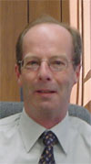
Hall of Fame
2018 Inductees
Rich Lyons

Slide 87
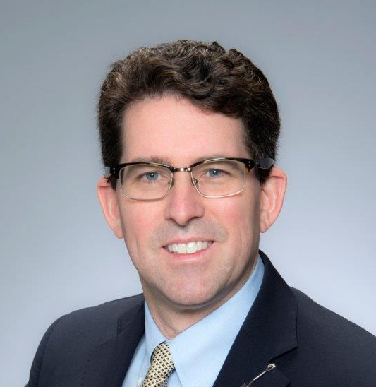
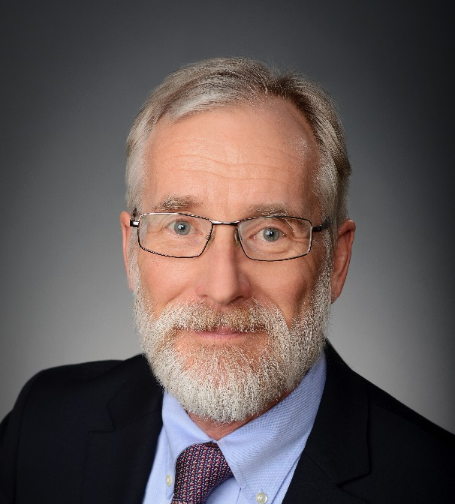
Passing of the Gavel
Geoff Baldwin and Robert Wither

Slide 88
Moving on…
Technical Sessions begin at 1:30pm

