Slide 1
Arkansas Water Environment Association
Wastewater Awards Luncheon
April 30, 2018

Slide 2
WEF MA Awards
…. Recognizing contributions and dedicated service to WEF and to the advancement of the water environment profession.

Slide 3
Laboratory Analyst Excellence Award
Recognizes individuals for outstanding performance, professionalism, and contributions to the water quality analysis profession.

Slide 4
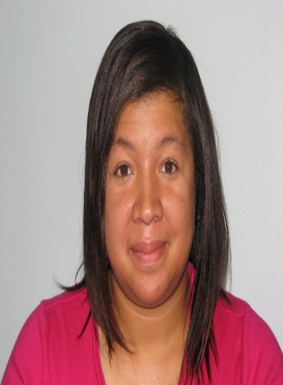
Stacy Carpenter
Pine Bluff Wastewater Utility
  22 Years of Experience
Environmental Compliance Supervisor
Boyd Point Treatment Facility received NACWA Platinum8 Award

Slide 5
George W. Burke Facility Safety Award
Recognizes a municipal or industrial wastewater facility for establishing and maintaining an effective safety program.

Slide 6

Little Rock Water Reclamation Authority
2017 – LRWRA experienced 4 reportable accidents
2017 – Zero (0) lost time accidents
Maintains a 1.83 Accident Frequency Rate vs. an industry average of 7.0

Slide 7
William D. Hatfield Award
Presented to operators of wastewater treatment plants for outstanding performance and professionalism.

Slide 8
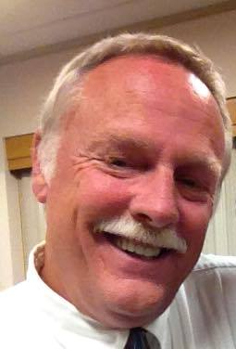
Loren Sharp
Springdale Water Utilities
30 Years Experience
15 Years as Operations Supervisor
AWWMA – President 2014-2015

Slide 9
Arthur Sidney Bedell Award
Acknowledges extraordinary personal service
to a WEF Member Association.

Slide 10
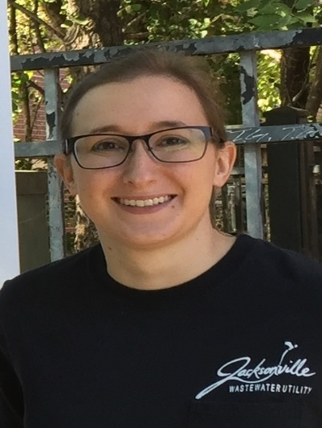
Alecia Patton
Jacksonville Wastewater Utility
GIS Coordinator
AWEA – Secretary
AWEA – Communications Chair
WEF – Delegate-at-Large

Slide 11
Quarter Century
Operator Club

Slide 12
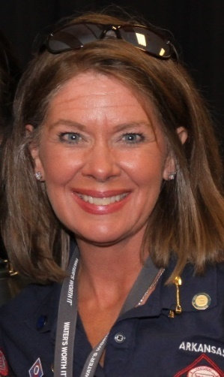
Dr. Lisa Ellington
Paragould Light, Water & Cable
27 Years Experience
AR Wastewater Licensing Committee
EPA Region VI Pretreatment Assoc.
AWW&WEA Past President
AWEA Past President
AWEA WEF Delegate 2005-08

Slide 13
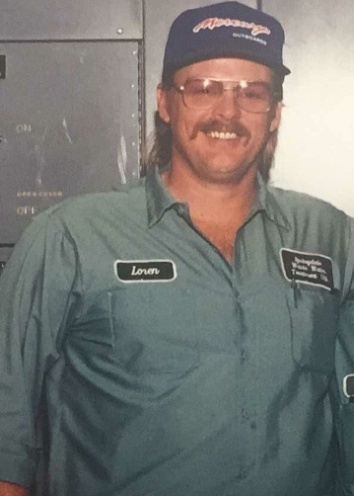
Loren Sharp
Springdale Water Utilities
30 Years Experience
15 Years as Operations Supervisor
AWWMA – President 2014-2015

Slide 14
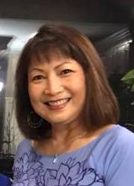
Duyen Tran
Jacobs – Fayetteville, AR
Former AWEA Executive Board Member
Former AWEA WEF Delegate
Former WEF Speaker of the House of Delegates

Slide 15
Arkansas Water Environment Association
Wastewater Awards Luncheon
April 30, 2018

Slide 16
AWEA Awards
…Recognizing outstanding contributions to Arkansas' water environment and to the water environment profession.

Slide 17
AWEA Collection System Award
Acknowledges an individual who has dedicated their career to the wastewater collection field and has made outstanding contributions in the area of wastewater collection systems.

Slide 18
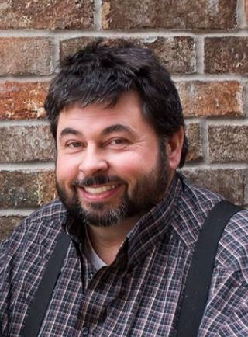
Jay Summers
Jacksonville Wastewater Utility
Collection Systems Manager
28 Years of Experience
Class IV Operator – Class II Collections System Certification
Class 3C Master’s Solid Waste License

Slide 19
AWEA Laboratory Analyst Award
Acknowledges a laboratory analyst who has demonstrated outstanding professionalism and performance and has made significant contributions to the water quality analysis profession.

Slide 20

Nicholas King
Jacobs – Fayetteville, AR
Lab Analyst II
11 Years of Experience
Regional Lab Coordinator
Expertise in all lab analysis spectrophotometry
Expert in detection limits

Slide 21
AWEA
Pretreatment Professional of the Year
Acknowledges a pretreatment professional in an industry or a utility who has demonstrated outstanding professionalism and performance and has made significant contributions to the pretreatment profession.

Slide 22
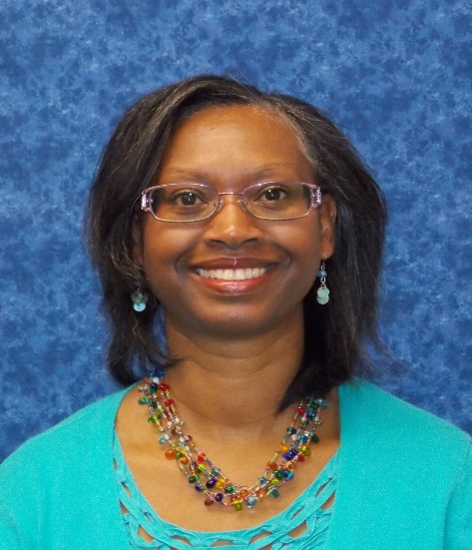
Myra Taylor
Jonesboro City Water & Light
Lab Supervisor & Pretreatment Coordinator
28 Years Experience - 15 Years as Supervisor
Previous AWEA Lab/Pretreatment Chair
Supervises inspections, audits, & incorporates regulation changes

Slide 23
AWEA
Safety Award for Cities with a Population > 20,000

Slide 24
Little Rock Water Reclamation Authority
2017 – LRWRA experienced 4 reportable accidents
2017 – Zero (0) lost time accidents
Maintains a 1.83 Accident Frequency Rate vs. an industry average of 7.0

Slide 25
AWEA
Safety Professional of the Year
Acknowledges a safety professional who has shown excellence in improving or increasing the awareness of safety in a utility/city.

Slide 26
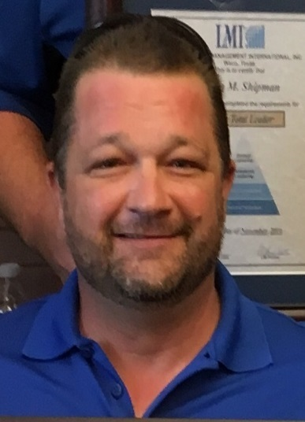
Chris Earl
Bentonville Wastewater Utilities
10 Years as Safety Program Director
Uses Program to teach and to engage staff members to observe and think safety
Actively engaging the next generation of safe professionals

Slide 27
AWEA
Young Professional of the Year
Acknowledges a Young Professional who demonstrated outstanding professionalism and performance in the wastewater industry.

Slide 28
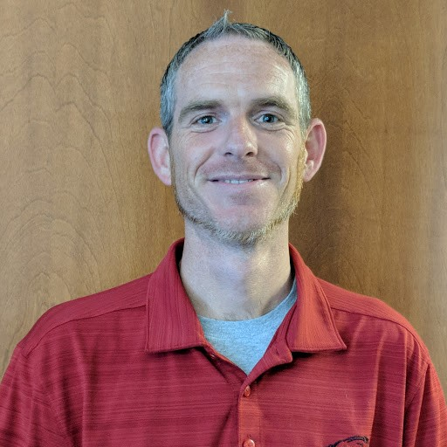
Quinten Nelson
Little Rock Water Reclamation Authority
13 Years of Service
Critical role in $173M Collection System & SSO reduction project
Hospitality Committee for AWW&WEA

Slide 29
Jim Bailey Educator of the Year
Acknowledges an Arkansan who strives to inspire fellow Arkansans, young and old, with enthusiasm and desire to protect the state's water environment, understand environmental issues and further environmental education.

Slide 30
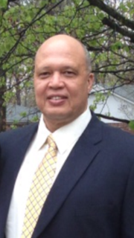
Kenneth Johnson
Pine Bluff Wastewater Utility
34 Years Experience - 17 Years as Manager
Implemented Public Education Program – Site Tours & Educational Opportunities for area school districts
Promotes Environmental education through public outreach events

Slide 31
Mike Thomason
Wastewater Manager Award
Acknowledges a wastewater utility manager who has shown excellence in community service, employee mentoring, or environmental stewardship.

Slide 32
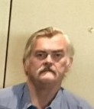
Terry Long
Eureka Springs Public Works Department
13 Years as Manager
2017 Operator of the Year for the NW District
SBR Activated Sludge Treatment Facility

Slide 33
Arkansas Water Environment Association

