Slide 1
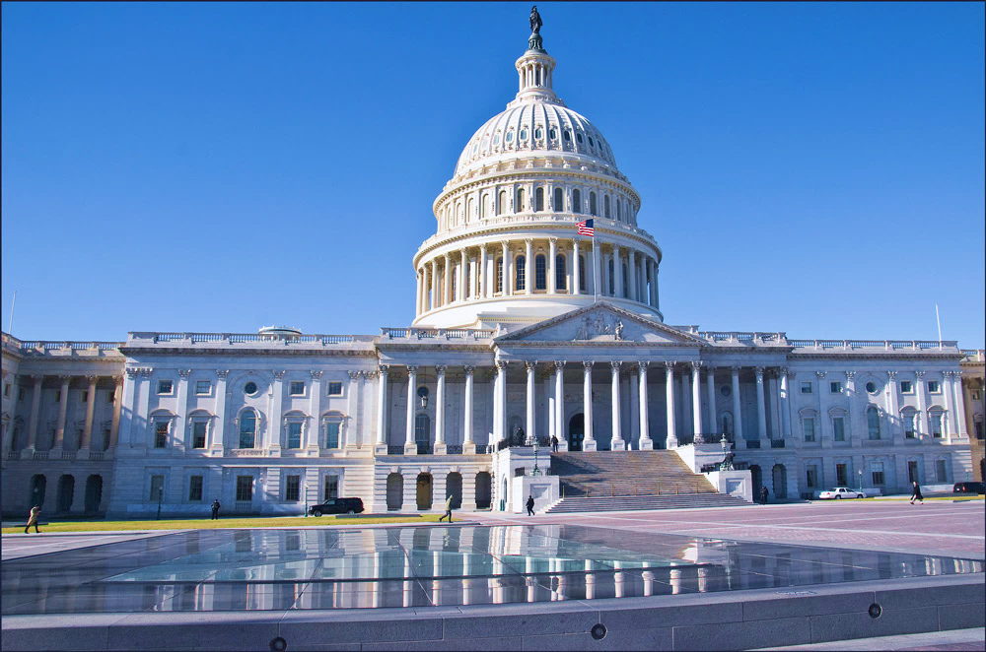
WEF’s
PROGRAM
WATER ADVOCATES
August 2021

Slide 2
| WEF Water Advocates Program
WEF’s Water Advocates program empowers you to share your knowledge and expertise to inform government decision-makers about the importance of water.
Water Advocates
Program Established
“The Water Advocates Initiative is a training and engagement program for members to promote grassroots advocacy with the goal of creating a network of trained water advocates in every state.”
First successful grassroots action!
strip rider by Sen. Kirk (R-IL) that forbid CSO discharges into The Great Lakes.
Have had 4-5
Calls-for-Action per
year since 2016!
2013
2014
2015
2016
2018
Notes:
WEF’s Water Advocates program empowers you to share your knowledge and expertise to inform government decision-makers about the importance of water.
The program was established in 2013 and has evolved into powerful tool for grassroots participation for WEF members to advocate for water.

Slide 3
| WEF Water Advocates Program
WEF.org – Advocacy tab
http://wef.org/ advocacy/water-advocates/
Notes:
You can link to the Water Advocates’ page from the main page on WEF’s website

Slide 4
| WEF Water Advocates Program
Click to advocate:
Generates an editable electronic letter to your Congressional Senators and Representative
Notes:
To make your participation in the Water Advocates program easy and rewarding, WEF has developed several resources, and more are on the way.
WEF recently launched a new website specifically for the Water Advocates program. The site has:
Calls-to-action on legislation,
An easy to use tool to email your Congressional representatives about an important bill or regulation
Research on important bills and regulations
News updates
And information about upcoming important events and meetings, such as the annual Washington, DC, fly-in
Also on the website is a new grassroots guide and toolkit. It’s loaded with useful information about how to be an effective grassroots advocate
Here is an example of a call-to-action that you can send to your Congressional representatives

Slide 5
| WEF Water Advocates Program
Notes:
The text is pre-written but you can customize before submitting

Slide 6
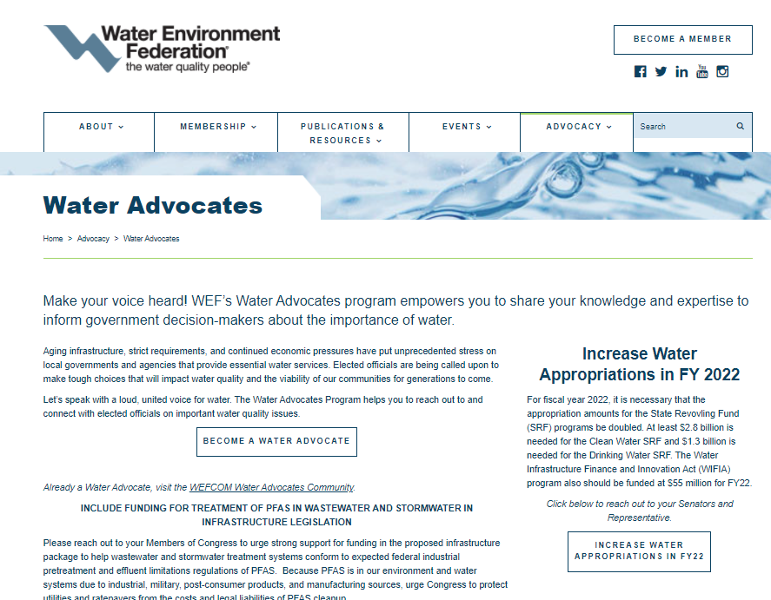
| WEF Water Advocates Program
Click to join:
Generates an email for you complete your contact information and send to WEF:
Name
Title
Organization Name
Telephone Number
Mailing Address
Notes:
Please join the Water Advocates program. All you need to do is send an email to wateradvocates@wef.org with your name, title, organization and contact info. WEF will enter your info into their database and you will receive regular info about actions you can take to be a grassroots voice for the water sector.

Slide 7
| WEF Water Advocates Program
Recent Successful Calls-to-Action:
20
20
Include Funding for Water in Covid Relief Legislation
1,668
Result: $638 million in low-income ratepayer aid
Letters Sent
20
20
Help to Wastewater in PFAS Legislation
1,047
Result: Provisions WEF was opposed to got dropped from bill.
Letters Sent
42
Result: NPDES extension was added to House water infrastructure package.
20
19
Support NPDES Permit Term Legislation
Letters Sent
20
17
Strip Wipes Rider from FY18 Appropriations bill
262
Result: Result: Rider dropped from the bill.
Letters Sent: Targeted to member of the House
Appropriation Committee
Notes:
Here are some results and statistics about WEF’s advocacy efforts

Slide 8
| WEF Water Advocates Program
Current Calls-for-Action:
Include Funding for Treatment of PFAS in Wastewater and Stormwater in Infrastructure Legislation
Increase Water Appropriations in FY 2022
Always Include Water in Infrastructure Packages
Key Contacts at WEF:
Steve Dye
WEF Director of Legislative Affairs
sdye@wef.org
Claudio Ternieden
WEF Sr. Director of Government Affairs
cternieden@wef.org
Susan Sullivan
WEF Vice Chair GAC &
HOD Federal Advocacy Workgroup Chair
ssullivan@neiwpcc.org

