Slide 1

WEF Member Associations
Strategic Planning & Goal Setting
Do-it-Yourself Template
Courtesy of Water Environment Federation
by Linda Kelly
Notes:
Want to provide context for retreat

Slide 2

Objectives
Have agreement on the process and level of member engagement
Have a common understanding of the definitions of vision, mission, values, strategies, goals, objectives, performance measures, action plans
Have agreement on the time span for the strategic plan
Have agreement of our MA’s strengths, weaknesses, opportunities, threats (SWOT Analysis)
Develop our vision/mission/values, goals and objectives using (SMART attributes)
Notes:
Strategic planning is the process by which you will envision the future and identify the areas on which you want the current and future leaders to focus.
Strategic planning is NOT an attempt to make future decisions now, nor is it an attempt to blueprint the future in a static, unchanging model. Meant to guide and engage.
A strategic plan is your game plan. A game plan evaluates the current condition or level of resources and sets a direction through a series of uncertainties while also understanding that certain externalities may require you to adjust your plan at any given moment.
Strategic planning requires the assoc. to clearly identify core priorities.
To be utilized for decision making. It will help the association answer this question when new ideas are identified: “Will it help us move closer to achieving one of our strategic goals?” If the answer to these questions is “No,” then you should reconsider the idea or the strategic plan.

Slide 3


Suggestions for Process
Utilize someone familiar with strategic planning to facilitate…doesn’t necessarily have to be a third party, but primary role should be the process and not participation
Use a smaller group/team (9-11) of diverse members to do the assessment, then report back to the larger group
Set regular meetings (monthly) and a reasonable timeframe to complete (6 months – 1 year)

Slide 4
Assumptions as a launching point
The MA Board is interested in being a more strategic, deliberate and forward looking Association
  Need X-X year useful and living strategic plan to guide priorities and activities
  Need an inclusive process developed in a collaborative manner with input from key stakeholders
  Need data about our membership needs/expectations, the competition, the trends, etc.
  Need Board to take ownership of the plan and embrace a willingness to implement
  Need clear understanding of objectives and action plans
  Need clear, simple process for measuring performance
Notes:
Most strategic plans are 3-5 years but intended to be on-going and updated yearly.

Slide 5

Getting on the Same Page
Some important success factors for our work plan:
  You have the power to chart the course for this organization
  This is hard work; worth the effort
  Work from the same definitions/vocabulary so we don’t get tripped up during the process
  Just start/do it. Stay with it. Get smarter as you go.
  Goal-setting/measuring critical, but don’t let it consume you
  Given your volunteer and money resources, focus on being realistic in your goal-setting; understanding you likely can’t be all things to all people

Slide 6
A Tool to Help Assess Association Status
STRENGTHS (that will enable us) What skills do we have among our leaders? What advantages do we have due to people, processes, technology? What do we do better than others? What do others perceive as our strengths? What can we focus on that would be difficult for a competitor to replicate? | WEAKNESSES (to overcome) What essential skills, technologies, processes are missing? What advantages do competitors have due to people, processes, technology? What obstacles must the strategy overcome? Consider how competitors will respond as you implement your strategy.
OPPORTUNITIES (to grasp for success) What trends or conditions may positively impact WCWEA? What opportunities are available to you? What can you offer your members you haven’t been? | THREATS (that could derail strategy) What trends or conditions may negatively impact WCWEA? What are competitors doing that may impact us? Do we have a solid financial base?

Slide 7
SWOT ANALYSIS -- US SJWP EXAMPLE
STRENGTHS Recent increase in prize from $3,000 to $10,000 Uniquely established as only water science research competition Experienced staff project manager Member Association Involvement – willingness to judge, pay for student airfare, host national event WEF financial / leadership support Reputation/high quality/high standards established | WEAKNESSES Lack of competitive strength to other STEM related competitions Reliability/lack of data re impact Strategic plan and goals/measures revised in 2012 less than aggressive Teacher involvement in US event discontinued Number of student entries remained much the same for many years**
OPPORTUNITIES Potential opportunity for members and other individuals to contribute on line via a ‘donate now’ button on website Newly created sponsorship tiered structure New model for hosting national at university Social Media promotion and networking Partnerships – teacher associations, research institutions | THREATS Economic conditions in past few years have reduced opportunities for corporate sponsorships Sustainable financial support/costs – substantial MA expenses have challenged some to balk at funding More difficult each year to keep high profile at WEFTEC Opening General Session due to higher profile initiatives/time constraints

Slide 8
A Tool to Help Assess Association Status
STRENGTHS (that will enable us) | WEAKNESSES (to overcome)
OPPORTUNITIES (to grasp for success) | THREATS (that could derail strategy)

Slide 9
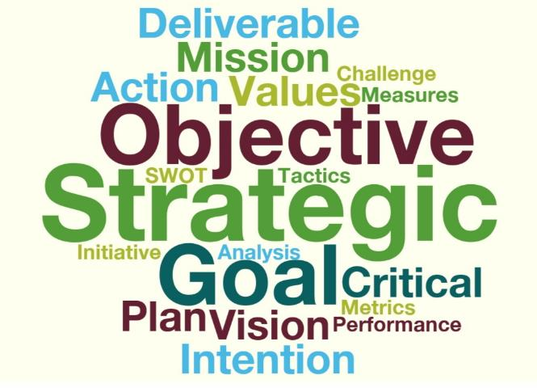
Working From the Same Definitions
There are many words commonly used in Strategic Planning
Notes:
-

Slide 10

How it fits together
Where we need to be in the future
Vision
Why we exist
Mission
What we believe
Standards of conduct
Values
Things we must do
Goals
How/when we will do them
Objectives
Monitoring success
Measures

Slide 11
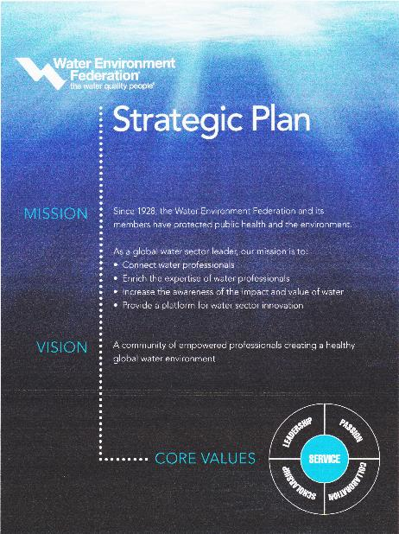
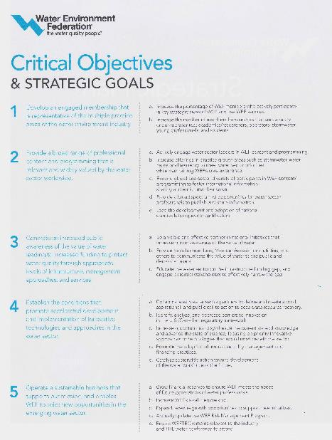
WEF’s Strategic Plan (as example)

Slide 12
Our Starting Point - Values
Values Brainstorming (What we believe; standards of conduct)
Notes:
Start with current Vision if one exists, brainstorm key words that should be in the vision for why your organization exists. Look at other visions, especially WEF’s and other MAs.

Slide 13

Values Example
(Example courtesy of Rocky Mountain WEA)
Core Values are what support our vision and mission; they shape our culture, and reflect who RMWEA is and how we operate
Mission Statement is our "purpose in action"; it's what we do every day to achieve our vision with direction from our values
Vision Statement is what RMWEA aspires to be; it helps drive decisions, focus goals, and is our overarching purpose in everything we do
Vision
Mission
Values
Notes:
Start with current Vision if one exists, brainstorm key words that should be in the vision for why your organization exists. Look at other visions, especially WEF’s and other MAs.

Slide 14
Our Starting Point - Vision
Vision Brainstorming (where we need to be in the future – key words that should be in our Vision)
Notes:
Start with current Vision if one exists, brainstorm key words that should be in the vision for why your organization exists. Look at other visions, especially WEF’s and other MAs.

Slide 15
Our Starting Point - Mission
Mission (why we exist)
Notes:
Start with current Mission if one exists, brainstorm key words that should be in the mission for why your organization exists. Look at other missions, especially WEF’s and other MAs.

Slide 16
Definition of Strategic Goals & Objectives
Strategic Intention is a few ‘header’ words summarizing intent of goals (what we want to accomplish)
Goals are about what we want to accomplish
Objectives
  Describes how that change will be accomplished
  Usually 3-5 years in scope
  Basic types:
    Generic (i.e. growth, expansion/retraction, new products/services - adding translation)
    Competitive (owning our product -- more value/better price)
Notes:
Generic (general) strategies
Growth i.e. the expansion of the organization to purchase new assets (website, etc) and to develop new products (i.e. Spanish translation of materials or new conference/workshop)
Retraction involves cutting back to focus on core business: referred to this as 'sticking to the knitting' - i.e. concentrating on what you do best.
Competitive advantage
Competitive strategies are concerned with doing things better than rivals. To be competitive an association shouldn't just copy the ideas of rivals. They should seek to out compete rivals.
Bad strategy is ‘magical, fluff’
Good strategy focuses on critical issues and how to address them
Requires research, data, analysis, hard choices, decisive planning and action

Slide 17
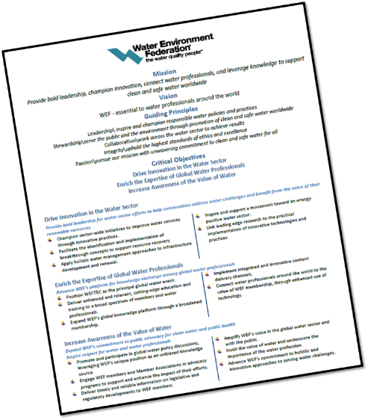
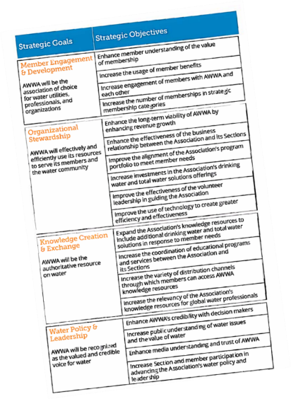
Definition of Strategic Goals & Objectives
Strategic Objective
(Critical Objective)
Strategic Intentions are about what we want to accomplish
AWWA
Goal
Strategic Objective
(Goal)
Objective
Goal
Objective

Slide 18

Goals and Objectives: What’s the Difference?
Goals are broad; objectives are narrow
Goals are general intentions; objectives are precise
Goals are intangible; objectives are tangible
Goals are abstract; objectives are concrete
Example:
Goal: To boldly go where no man has gone before.
Objective: Explore the Planet Tatooine by June 2017, within the budget of $20M Galactic Credits.
Notes:
"To boldly go where no man has gone before." You can't measure it, and you probably will never know if the goals were accomplished.
State goal simply and resolutely.
State it confidently, but recognize "Did you accomplish your goal?" can never be answered in the absolute affirmative.
Objectives are specific and measurable. They can be output objectives, or they can be attitudinal or behavioral. But most of all, they can be measured. They are concise. They are specific.
Objectives should measure impact. Behavioral objectives are preferred ("Exactly what is it you want to get them to do?"), but the objectives can also be attitudinal ("What do you want them to think?"), or informational ("What do you want them to know that they didn't know before?").
State objectives in specific and quantifiable (measurable) terms whenever possible. Set them in a time frame, and if you know what the budget is, tell what you expect the cost to be. The objectives should be reachable
A crystal-clear objective would read something like this: "Our objective is to deliver X results by Y date at a cost of Z dollars."

Slide 19

Building the plan

Slide 20

Step 1:
List Topics for Strategic Intentions & Goals
  Brainstorm the topic areas for the strategic intentions & goals (look to mission, existing intentions/goals and SWOT analysis for ideas)
  Group like topics
  Prioritize top 5 (but keep track of next 5)

Slide 21

Step 2:
Strategic Intentions & Goals
  Agree on top X Priority Strategic Intentions
  Agree on top X Priority Goals

Slide 22
Step 3:
From your general goals, create specific objectives under each one (consider the SMART attributes as you develop the specific objectives)
Goal:
To make WEF Highlights the most effective and efficient member communication channel.
Objective:
Increase Highlights average monthly readership by 10% between Jan. 1 and July 30, 2014.

Slide 23
When thinking of SMART Objectives:
  Specific
  Bad Example: Increase participation of members.
  Good Example: Increase attendance at annual conference by XX.
  Measurable
  Bad Example: More members will attend…
  Good Example: 80% of members will attend annual conference.
  Attainable
  Bad Example: 100% of members will attend every meeting.
  Good Example: Increase attendance at annual conference by 10% from the prior year.
  Relevant
  Bad Example: Teach all members to make a great pizza.
  Good Example: Ensure the highest quality water reuse training is available to members by xxx.
  Time-Oriented
  Bad Example: Winter
  Good Example: January 30, 2017

Slide 24
Step 3:
Developing Specific Objectives under Broad Goals
  Break into X groups and develop a draft Objective for each assigned goal (keeping them ‘SMART’)
    Choose a facilitator
    Choose a spokesperson to report out
    XX minutes to develop
    Spokespeople report out
    Group to agree on objectives

Slide 25
Review of what we accomplished thus far
  Thoughts about the Process?
  Thoughts about the Vision?
  Thoughts about the Mission?
  Thoughts about the Values?
  Thoughts about the Strategic Intentions?
  Thoughts about the Priority Goals?
  Thoughts about the Objectives under the goals?

Slide 26
Step 4: Setting the performance measure
Metrics: methods by which we measure success (or lack thereof)
Quantitative:
  Predictive
  Statistics/numbers (time, costs, profit, percentage, etc.)
  Examples: website clicks, cost to serve, 27% increase
Qualitative:
  Typically non-numerical, less precise, behavioral, may be answered by ‘yes or no’
  Measured through surveys, observing, insights
  Examples: customer experience, quality of the event, were you proud of it

Slide 27
Step 4:
Putting it all together
  Use a ‘tool’ to fill in the blanks with your newly developed vision, mission, values, strategic objectives, goals, objectives
  Add performance metrics and action plans

Slide 28
XXX XXXX
Water Environment Association
LOGO
Strategic Plan - Work Plan date
Vision slkdjflkdjlkgjlksjdlkgjlksdjlgkjslskjglksjdglkjsldkg
Mission
Lksdjfldkjfldkjflskjflksdjflksflksjflksjlf
;slkdfjlskdfjlskdjflksjflksjld
Core Values
Sldjfdkljflkdsjlkfjl
Sdlfkjslkfdjlsdk
Lskdfjdks’
Lskdfjlskdjfksjf
Lsdkflksjdlsjf
Putting it all together – a format

Slide 29
Putting it all together – a format
EXAMPLE: Strategic Objective: Member Value
Goals | Objectives | Action Plans & Metrics | Leader
Goal #X: Facilitate Knowledge Exchange | Objective Xa: Successfully implement technical training - XXX seminar - June XX, 2017 with 120 attendees and a member evaluation that rates the program 4-5 (with 5 being excellent)
Strategic Objective: XXX
Goals | Objectives | Action Plans & Metrics | Leader
Goal #X: XXXX | Objective Xa: XXXXX

Slide 30

Next Steps
On-going Board duties:
  Continuous improvement
  Assigning roles (or champions) to begin implementation
  Continuous reporting/checking in until it becomes routine and on schedule
  Planning to roll out to the membership/communication
  Get back together for progress reporting and realignment regularly

