Slide 1






The Utility of the Future Today
JOINT RECOGNITION PROGRAM

Slide 2
Webinar Logistics
Participants are in “listen-only” mode to reduce background noise.
To submit a question, use the Q&A function.
Presenters will monitor these questions and respond to as many as possible during the “Q&A” session at the end of the presentation.

Slide 3
Welcome and Introductory Remarks
Jim Horne, U.S. EPA
Linda Kelly, Water Environment Federation

Slide 4
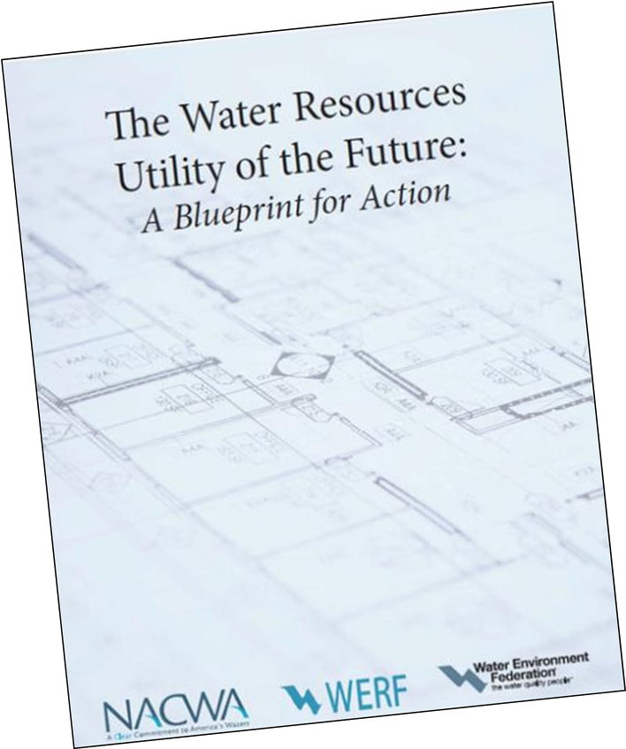
The Utility of the Future Today
The face of the wastewater industry is changing rapidly; new challenges and opportunities in the industry require creative solutions.
In 2013, NACWA, WEF, and WERF published the Utility of the Future Blueprint document.
The Utility of the Future Blueprint lays out a new vision for the industry, focusing on resource recovery, watershed protection, culture change, and community partnering.

Slide 5
The Utility of the Future Today
In 2015, WEF reached out to other partnering organizations, including EPA, about a joint recognition program for utilities of all sizes.
Building on the vision outlined in the Blueprint, the Recognition Program is designed to:
  further promote and enable the emergence of this new business model for the entire water sector;
  provide recognition for those achieving these outcomes;
  encourage peer-to-peer learning among utility members of the Recognition Program and with other utilities.

Slide 6
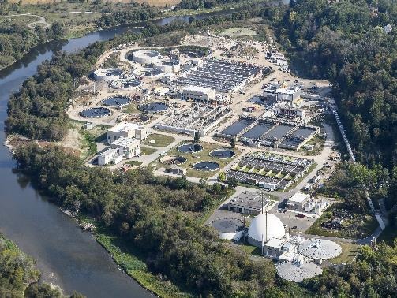
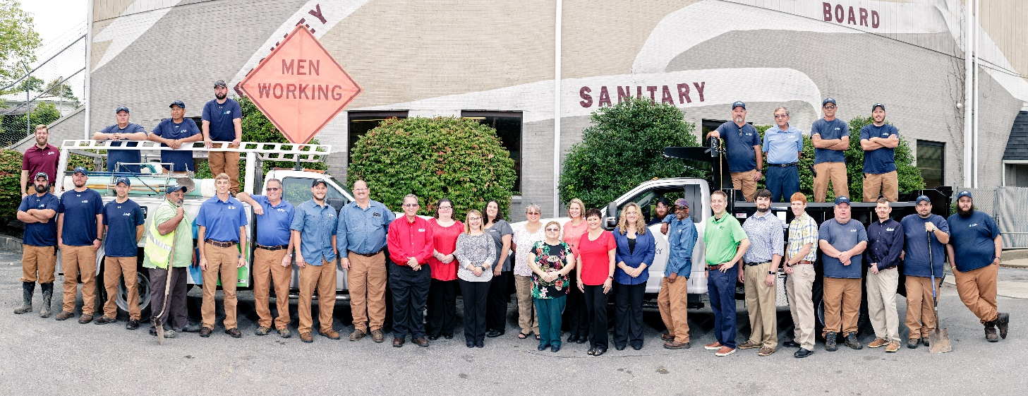
The Utility of the Future Today
The program launched in 2016
  Designed by utility partners, with input from staff from the partnering organizations
  It is a recognition program – applicants are evaluated based on program criteria, not against each other
  Utilities of all sizes are encouraged to apply

Slide 7

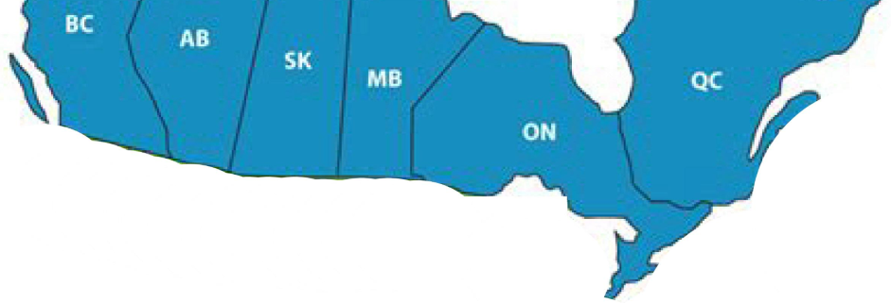
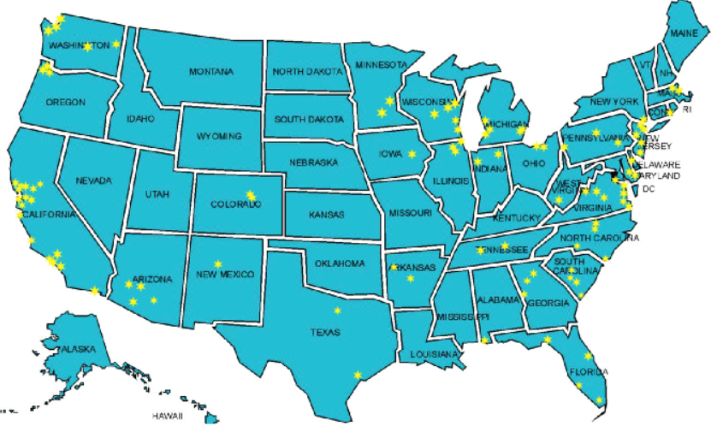
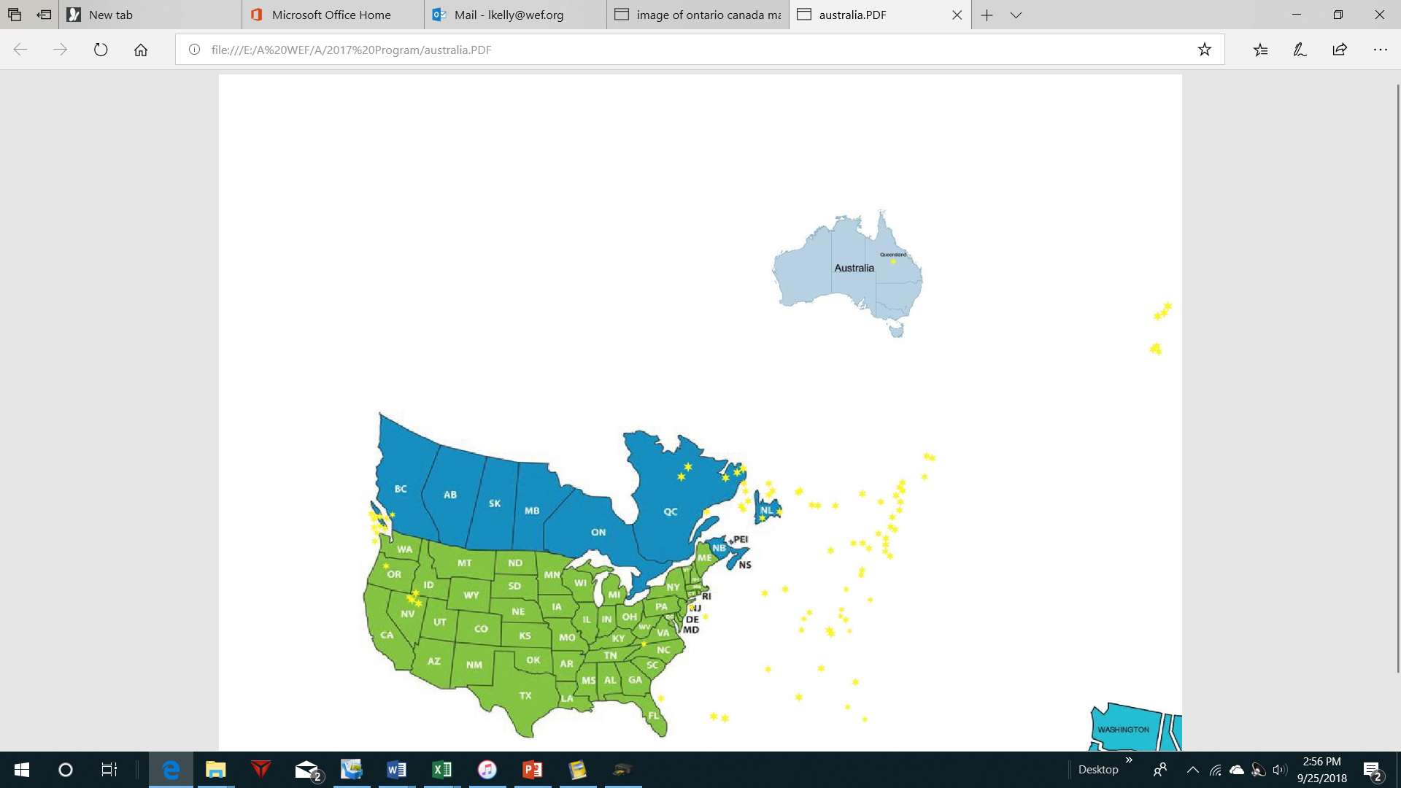
105 Utilities of the Future - TODAY

Slide 8
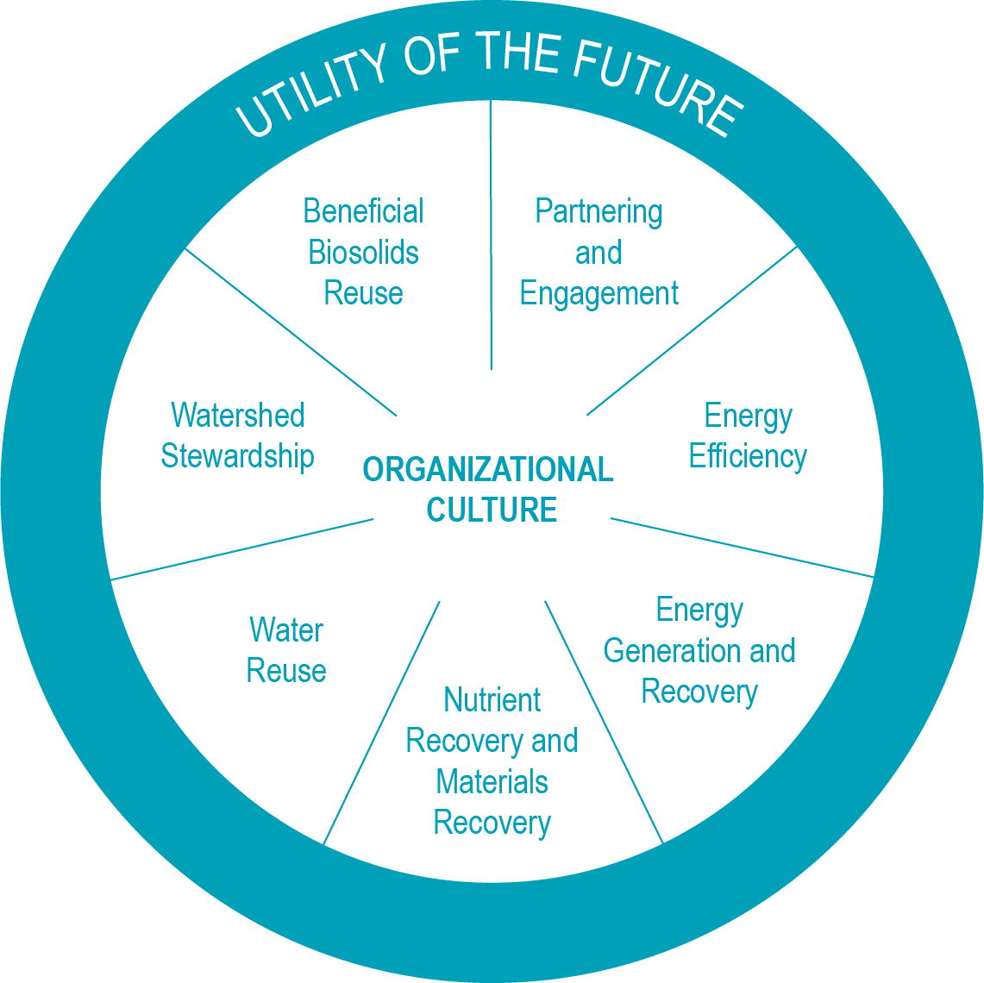
The Utility of the Future Today
Organizational Culture is essential to becoming a Utility of the Future.
Applicants submit a narrative outlining the actives and achievements in one of the seven Activity Areas.
The application is compact and streamlined, to limit the burden on applicants

Slide 9
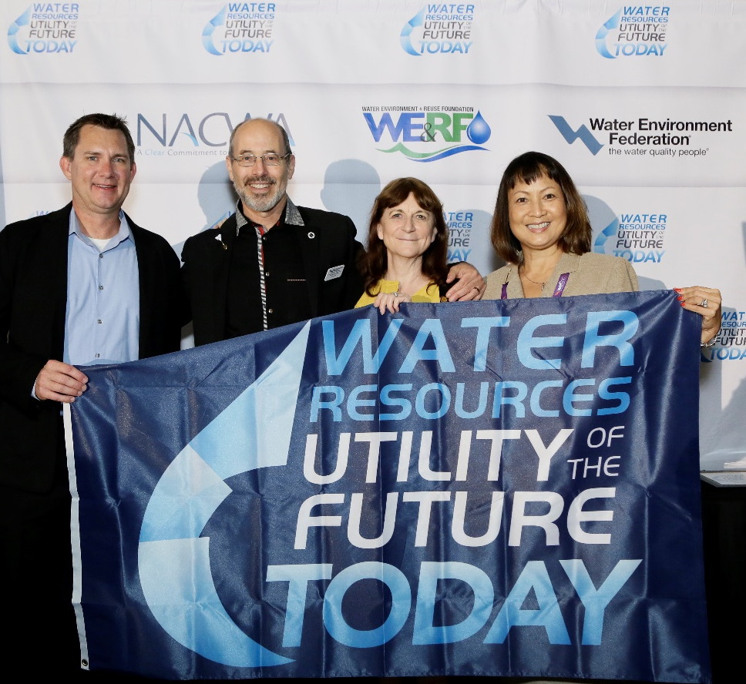
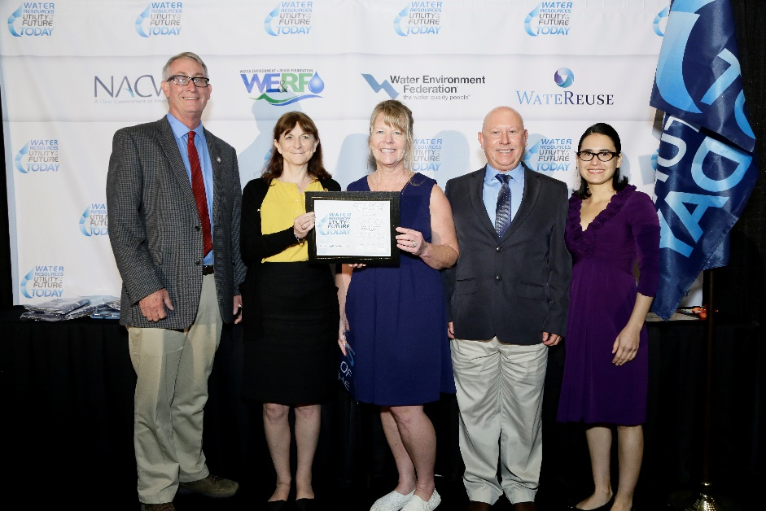
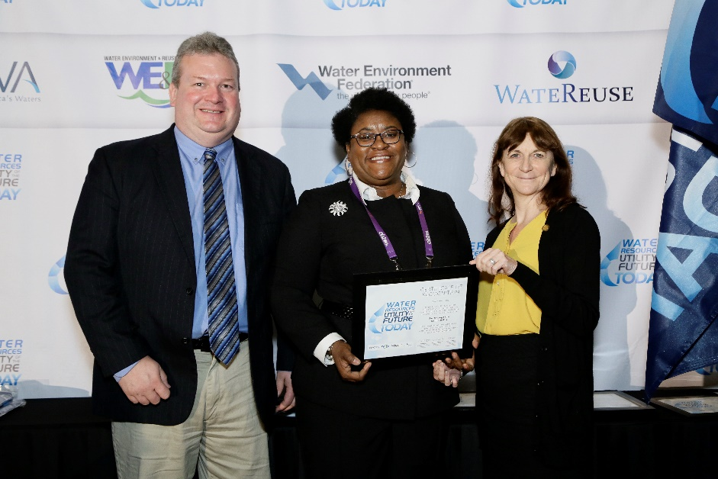
The Utility of the Future Today
Recognized utilities are acknowledged during a special ceremony at WEFTEC each year.

Slide 10
Application Overview
Rob Greenwood
Ross Strategic

Slide 11
Application Process and Recognition
Eligible Applicants
Public and private water sector utilities of all sizes
Applicants must have no major permit violations for the past year prior to application
Program Membership
Utility of the Future Today recognition is granted for a three-year period: Utilities that received recognition in 2017 or 2018 may submit materials to be recognized in one additional Activity Area. After three years, program members must renew their recognition.
Application Submission
Submitted as a Word document
Send to: UtilityRecognition@wef.org
Deadline: 5:00pm Eastern Time, May 31st
Notes:
For example: a utility recognized in 2016 in Watershed Stewardship may apply for recognition in 2017 and 2018 for one additional activity area per year by submitting materials only for that activity area and omitting application information related to Organizational Culture (Application Part 2). In 2019, the utility may reapply to renew their recognition.

Slide 12
Application Sections
Part 1: Background Information
Part 2: Utility of the Future Today Organizational Culture Narrative
Part 3: Utility of the Future Today Activity Area Responses
Part 4: Signed Certification Statement

Slide 13
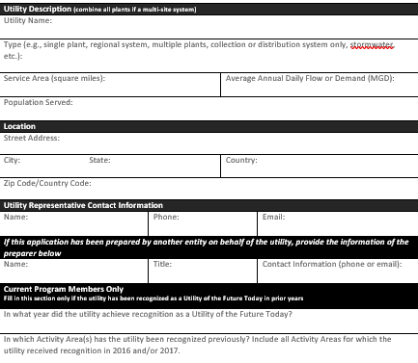
Part 1: Background Information
Recognition will apply on a utility-wide basis
Provide basic information about the utility
Designate a single point of contact
Specify if, and in what Activity Areas, the utility has been recognized in past years
Notes:
A change this year: The application has an area to note if the application has been prepared by another entity on behalf of the utility (e.g., a consultant). In this case, the application still needs to be signed by a utility representative in Part 4, as well as by the preparer.

Slide 14
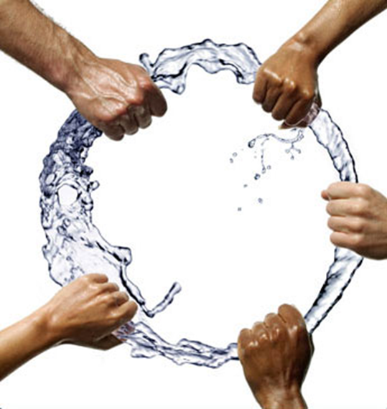
Part 2: Organizational Culture Narrative
“Utility of the Future Organizational Culture emphasizes a collaborative workplace that inspires and embraces continual improvement and learning through a high level of employee, community, and stakeholder engagement.”
Organizational Culture is the backbone of a Utility of the Future.
Each applicant must submit a narrative that provides an overview of its programs and practices relative to their utility’s Organizational Culture, in support of the Utility of the Future model.
Should provide highlights for all other Activity Areas for which the applicant seeks recognition.
A 500-1500 word narrative.
Notes:
To expedite the review process, the application review panel (consisting of six utility general managers/executives) specifically identified strong "Organizational Culture" narratives from three model applications from the City of Charlotte, Fairfield Sewer District, and the West County Wastewater District. Links to these examples are provided in Part 2 of the Application. The Review Panel strongly encourages applicants to review these.
Utilities may also wish to review successful applications, as they were submitted, from the 2016 and 2017 honorees (links are provided in the Application, and the Honorees Compendiums are available on the UOTF website).

Slide 15
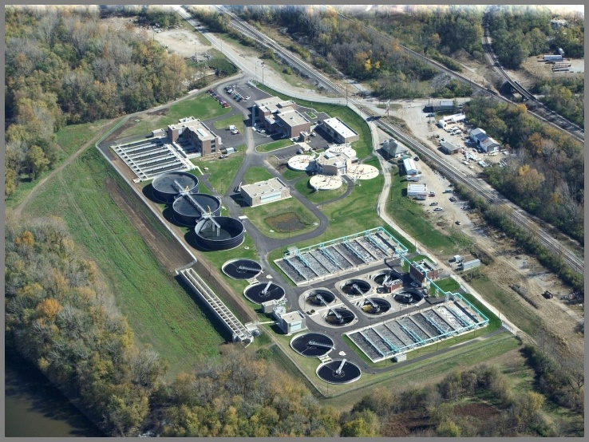
Part 3: Utility of the Future Today Activity Areas
Applicants must submit an Organizational Culture narrative and a description of one of the seven Activity Areas:
  Beneficial Biosolids Use
  Partnering & Engagement
  Energy Efficiency
  Energy Generation & Recovery
  Nutrient Reduction & Materials Recovery
  Water Reuse
  Watershed Stewardship
Notes:
Activity Area 1: Beneficial Biosolids Use
Activity Area 2: Partnering & Engagement -- Previously titled “Community Partnership and Engagement” and updated in the 2018 Program.
Activity Area 3: Energy Efficiency
Activity Area 4: Energy Generation & Recovery
Activity Area 5: Nutrient Reduction & Materials Recovery -- Previously titled “Nutrient and Materials Recovery” and updated in the 2018 Program.
Activity Area 6: Water Reuse
Activity Area 7: Watershed Stewardship 2016 Activity Area “Integrated Growth Planning” was removed from the 2017 Program and is encompassed in Activity Area 7

Slide 16
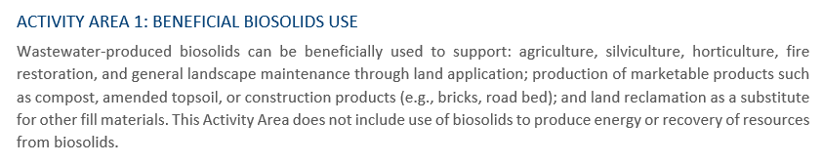
Part 3: Utility of the Future Today Activity Areas
Activity Area descriptions help to frame the Activity Area so that the applicant knows what types of items will be relevant in their response.

Slide 17
Part 3: Utility of the Future Today
Activity Area Description
Purpose: Demonstrate robust engagement in that Activity Area.
Three Components:
  Overview Paragraph
  Question and Answer
  Performance Measures and Results – 2 options for some Activity Areas
Example activities and measures are provided in Appendices 1 and 2.
Description should be no more than 2000 words.
Notes:
Applicants are required to provide a description of the practices/activities/programs implemented related to the Activity Area, as well as measures and results to demonstrate their performance in each Activity Area.
Example activities and measures provided in the Appendices represent a common range of activities and measures that may characterize ‘Utility of the Future’-level performance in the Activity Area.
While example activities and performance measures are provided, applicants may choose to use any measures that they believe are relevant

Slide 18
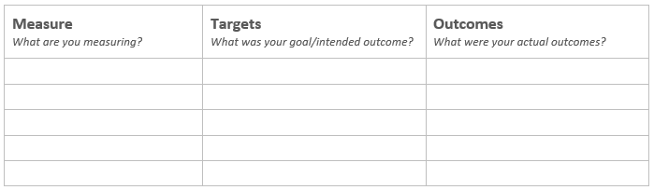
Part 3: Performance Measures and Results Options
Option 1…

Slide 19
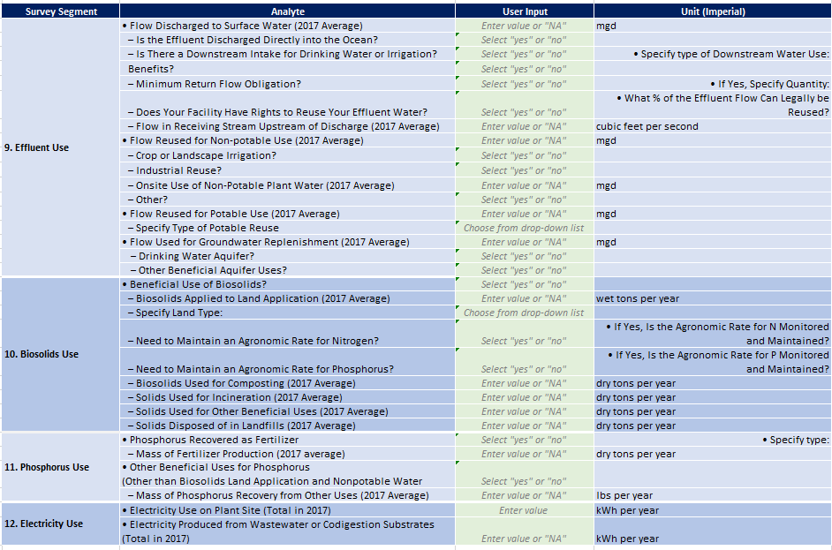
Part 3: Performance Measures and Results Options
Option 2…
WEF Resource Recovery Baseline Report Survey Template
Beneficial Biosolids Reuse
Water Reuse
Nutrient Reduction And Materials Recovery
Energy Generation And Recovery

Slide 20
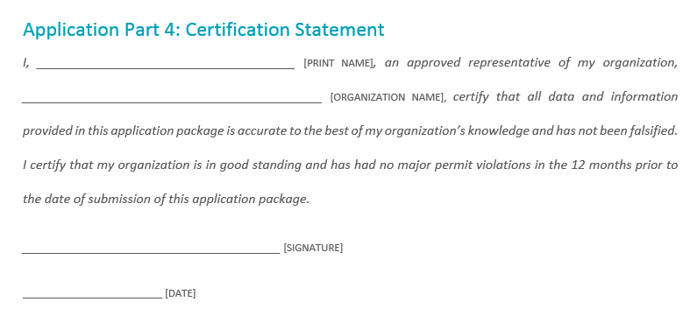
Part 4: Signed Certification Statement
Final piece of the application package.
Executive director or his/her designee certifies that all information provided is accurate to the best of the applicant organization’s knowledge.
Notes:
If the application has been prepared by another entity, preparer must also sign in the space provided.

Slide 21
Basis for Recognition
How will my application be assessed?
Successful applicants will demonstrate a strong Organizational Culture and that they are engaged in their selected Activity Area in a meaningful and robust manner, consistent with Utility of the Future concepts.
Reviewers will take into consideration an applicant’s current engagement and performance, as well as projected future results that may be described in the narrative portion of the application.

Slide 22
Future Awards
When can/should I reapply?
Recognition is valid for three years; Utilities that received recognition in 2017 or 2018 may submit materials to be recognized in one additional Activity Area in 2019.
Recognized utilities may reapply after three years to be recognized again.
When reapplying, recognized utilities may either:
  Demonstrate that they have made continual improvement and performance advancements in their originally recognized Activity Area(s);
  AND/OR
  Apply for recognition in new Activity Areas.

Slide 23
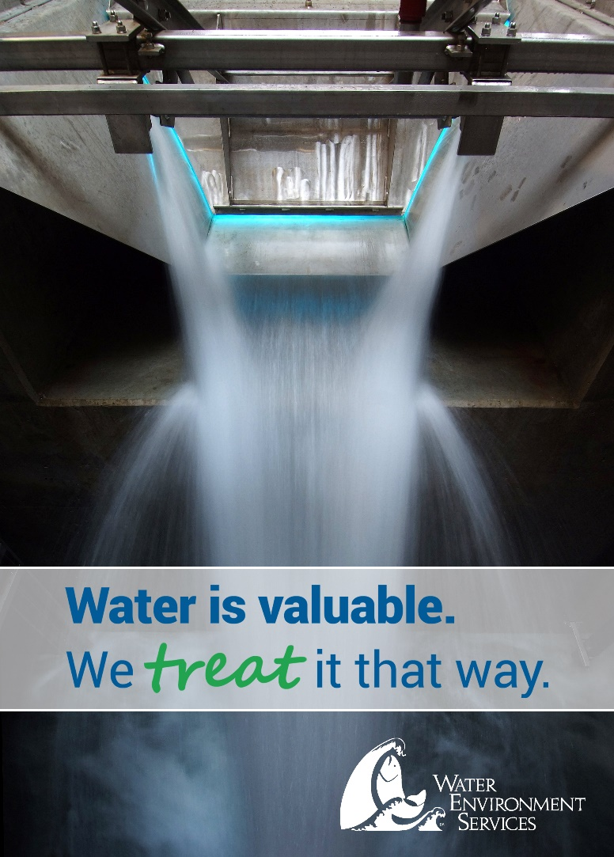
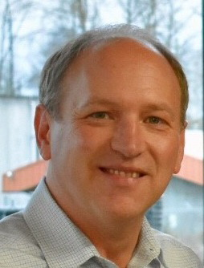
Water Environment Services, Oregon City OR
Utility of the Future Today
2018 Honoree for Category
“Partnering & Engagement”
Greg Geist
Director
Water Environment Services
ggeist@clackamas.us

Slide 24
Questions?
  Click Q&A to open the Q&A window.
  Type your question into the Q&A box. Click Send.

Slide 25
Reminders
There is an FAQ document on the UOTF Website; you can also send questions to UtilityRecognition@wef.org
Application Submission
Submitted as a Word document
Send to: UtilityRecognition@wef.org
Deadline: 5:00pm Eastern Time, May 31st
Applicants will be informed whether or not they were selected for recognition by or before July 12th, 2019

Slide 26
Closing Remarks
Jim Horne, U.S. EPA

Slide 27
Thank you!

