Slide 1



Slide 2
50 Years of WEF Leaders
President’s & Speakers Before Us

Slide 3

“We make a living by what we get, but we make a life by what we give.”
– Winston Churchill.
Notes:
Definition we use: The HOD is…. (elevator speech for what is the HOD)

Slide 4
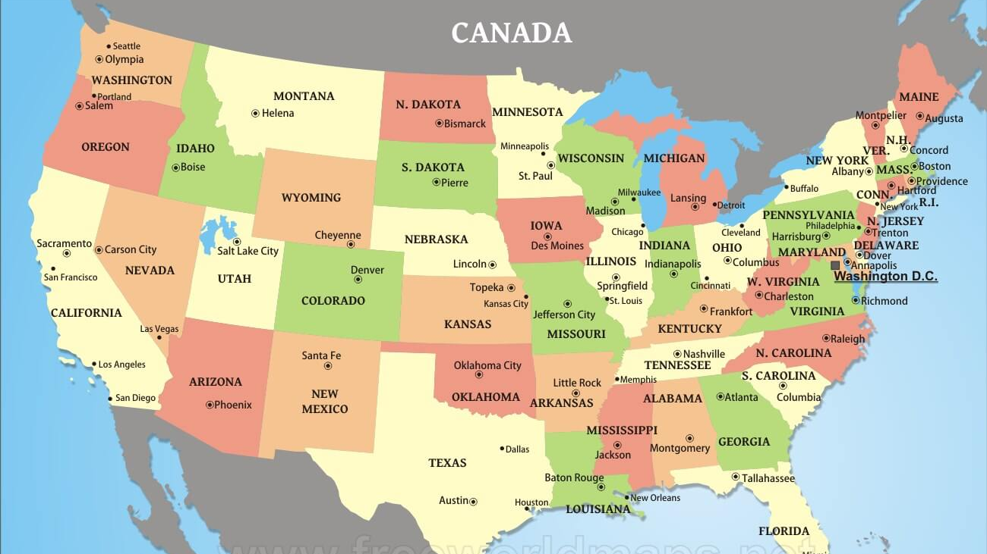
WEF President’s & Speakers

Slide 5
WEF Presidents
Paul Freedman (MI) ‘10
Cordell Samuels (ON) ‘13
Geoffrey Scott (ON) ‘80
Adam Zabinski (NY) ‘08
Michael Reed (PN) ‘06
Victor Wagner (CS) ‘76
Martin Lang (NY) ‘79
Jenny Hartfelder (RM) ‘18
Lynn Broaddus (CS) ‘20
Phillip Gerwert (MI) ‘94
Jeanette Brown (NE) ‘11
Henry Tow (CA) ‘85
Lynn Grijalva (NV) ‘05
Mohamed Dahab (NB) ‘07
Dick Kuchenrither (RM) ‘96
Richard Englebrecht (IL) ‘78
Carmen Guarino (PA) ‘81
Horace Smith (RM) ‘77
Larry Jaworkski (CH) ‘04
John Parkhurst (CA) ‘74
Rick Warner (NV) ‘17
Albert Goodman (IN) ‘00
Dale Jacobson (NB) ‘98
Jamie Eichenberger (RM) ‘22
Tom Kunetz (IL) ‘19
James Abbott (RM) ‘89
Henry Schwartz (MO) ‘86
Paul Bowen (GA) ‘16
Horace Smith (VA) ‘82
Jackie Jarrell (NC) ‘21
Roger Dolan (CA) ‘92
Jim Clark (CA) ‘02
Sandra Ralston (IN) ‘14
Matt Bond (KS) ‘12
Ed McCormick (CA) ‘15
Billy Turner (GA) ‘97
Joe Stowe (NC) ‘01
Rhonda Harris (TX) ‘99
Chuck Sorber (TX) ‘93
Charles Huber (GA) ‘87
Michael Pollen (AK) ‘95
Rebecca West (SC) ‘09
Sam Warrington (TX) ‘75
Charles Jones (GA) ‘83
Beth Turner (GA) ‘88
Charles Kaiser (TX) ‘91
Ernest Gloyna (TX) ‘84
Aimee Killeen (LA) ‘24
Robert McMillon (TX) ‘03
Arthur Saarinen (FL) ‘90
Ifetayo Venner (FL) ‘23
Notes:
Applied information collected from WEFTEC HOD Activity
Values (Draft):
Inclusion, equity, diversity
Service
Representation/service (servant leadership)
Leadership
Advocacy – Internal with MAs and WEF/External with Legislative/Representative empowerment (various ways)
Engagement
Collaboration
Openness
Communication/transparency
Active Listening
Curiosity – Ties to the openness that is there.
Authenticity/Respect

Slide 6
WEF Speakers
Tom Helgeson (PN) ‘09
Steven Drangsholt (PN) ‘22
Sean Osbourne (NE) ‘12
Howard Carter (NE) ‘17
Keith Hobson (IA) ‘19
Dean Miller (PA) ‘20
Nikita Lingenfelter (NV) ‘21
Jenny Hartfelder (RM) ‘13
Deborah Houseshell (OH) ‘08
Jamie Eichenberger (RM) ‘16
Fran Burlingham (CA) ‘11
Alexie Kindrick (OK)’24
Duyan Tran (AR) ‘15
Bill Orne (SC) ‘10
Janet Hurley Cann (SC) ‘14
Donell Duncan (GA) ‘23
Aimee Killeen (LA) ‘18

Slide 7
“You are not here merely to make a living. You are here in order to enable the world to live more amply, with greater vision, with a finer spirit of hope and achievement. You are here to enrich the world, and you impoverish yourself if you forget the errand."
- Woodrow Wilson

Slide 8
Thank You
WEF President’s & WEF Speakers
for Your Service!

Slide 9
HOD MESSAGE
Bill Davis
Speaker-Elect

Slide 10
Board of Trustees
House of Delegates
Delegates-At-Large
Member Association Delegates
Community Leadership Council
CLC Directors
WEF Executive Director
WEF Executive Team
WEF Staff
Communities
Notes:
Brief overview of the structure of WEF

Slide 11
Board of Trustees
House of Delegates
Delegates-At-Large
Member Associations Delegates
Community Leadership Council
CLC Directors
WEF Executive Director
WEF Executive Team
WEF Staff
Communities

Slide 12

WHAT IS THE HOD?
Representatives of the…
Notes:
Brief overview of what the HOD is comprised of – that we are the representatives of the federation

Slide 13
The House of Delegates Duties
The HOD Is the Deliberative and Representational Body of WEF
It advises the Board on matters of strategic direction and public policy development and by-law changes
Provides input to BOT as requested
Has authority to confirm and remove Trustees to the extent provided for in the Articles of Incorporation and these Bylaws
Reviews Budget for Consistency with WEF Strategic Plan and Initiatives
Informs Delegates of WEF Priorities and Initiatives
WEFMAX Events

Slide 14
Who?
Comprised of Delegates from Member Associations (MAs)
Number of Delegates is based on the membership size of each MA (3-year terms)
Delegates-At-Large (DALs) from Unrepresented Constituencies
12 delegates-at-large (4 per year are selected)
Speaker
Notes:
Member Association Delegates. Delegates shall be appointed or elected to the House by each Member Association, in accordance with House Policy and Procedures and the Member Association Bylaws. The number of Delegates appointed or elected from each Member Association is provided in the procedures established by the House. Member Associations shall retain rights to be represented by Delegates provided the Member Association Bylaws are in harmony with WEF Bylaws. Any Member Associations whose Bylaws are not in harmony with the WEF Bylaws may be subject to losing its rights of House representation.
Delegates-at-Large. Delegates-at-Large shall be recommended by the House Nominating Committee and confirmed by the House.

Slide 15

The HOD has…
7 Standing Committees:
  Steering
  Budget
  DE&I
  Nominating
  Water Advocacy
  Communications
  WEFMAX

Slide 16

The HOD has…
Work Groups:
  Change Annually
  Number varies
Notes:
More information on what the BOT does

Slide 17
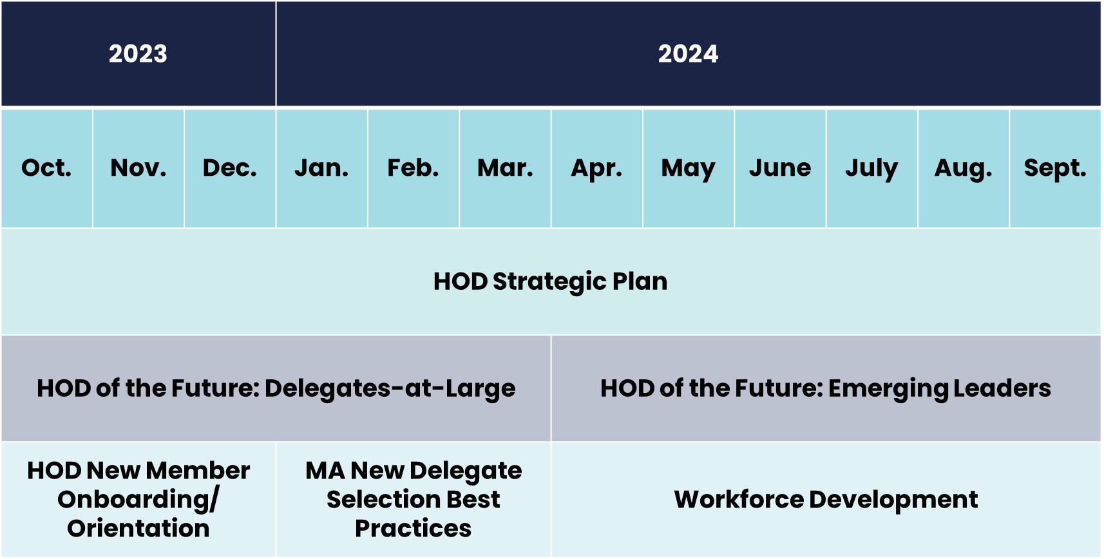
The HOD 2023-2024 Work Groups
Notes:
Brief overview of work groups for this year

Slide 18

BE CURIOUS, NOT JUDGEMENTAL
-attributed to Walt Whitman, used by Ted Lasso
Notes:
Theme for this year

Slide 19
How?
Humility
  Humility isn’t denying your strengths; It’s being honest about your weaknesses
Hustle
  To have the courage, confidence, self-belief, and self-determination to go out there and work it out until you find the opportunities you want in life.
Heart
  By living and working with heart, we create a deeper bond and impact with the people and the work we’re committed to.
Notes:
How can you be curious and not judgmental? By using humility, hustle, and heart

Slide 20

What?
HOD Strategic Plan
  Mission
  Vision
  Values
  Goals
HOD of the Future
  Emerging Leaders
  Delegates-at-Large
Funding
  WEFMAX t-shirts
  Increased budget requests
Steering Committee
  Speaker term lengths
  Past speaker roles
  By-law changes
Notes:
Here is where we are asking the questions and using our curiosity – focusing on humility, hustle, and heart

Slide 21
When?
Recognizing the need for change
Determining how to identify necessary changes
Identifying necessary changes
Implement near-term changes/goals
Implement longer-term changes/goals
Repeat steps as needed
WE ARE HERE
Notes:
Timeline for change

Slide 22
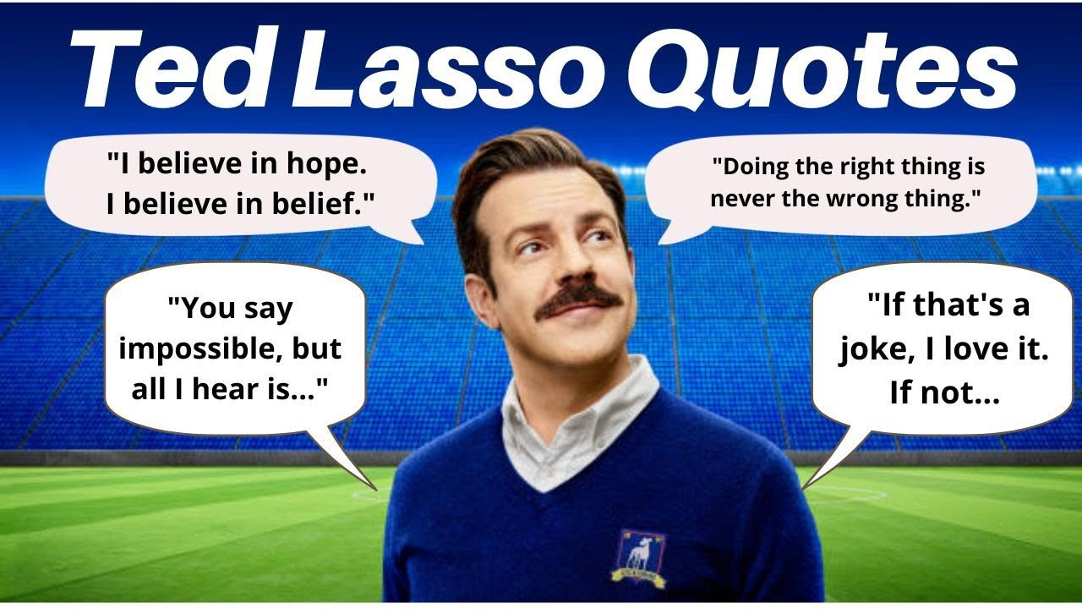
Why?
To better serve
  MAs
    Be more transparent
    Be more forward-facing
    Focus on important issues
    Be true resource
  WEF
    Help implement the strategic plan
    Be a voice for the Federation
  Ourselves

Slide 23
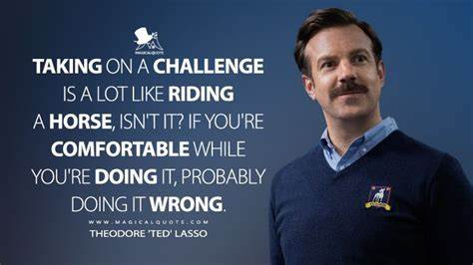

Slide 24

Thinking Outside of the Box…
BOT
HOD
CLC
MA

Slide 25

Thank you!

Slide 26
WEF House of Delegates
Committee Updates
Budget
DE&I
Water Advocacy

Slide 27
House of Delegates Budget Committee
Update
May 2024 WEFMAX
Park City, UT

Slide 28
HOD Budget Committee
Review WEF budget to assure alignment with strategic plan
Administer MA grant program
Participate in WEF $$-related committees (Chair and Vice-Chair)
  WEF Finance Committee
  WEF Audit Committee
  HOD Steering Committee
Other projects of our choosing relevant to budget issues
Notes:
Applied information collected from WEFTEC HOD Activity
Values (Draft):
Inclusion, equity, diversity
Service
Representation/service (servant leadership)
Leadership
Advocacy – Internal with MAs and WEF/External with Legislative/Representative empowerment (various ways)
Engagement
Collaboration
Openness
Communication/transparency
Active Listening
Curiosity – Ties to the openness that is there.
Authenticity/Respect

Slide 29
HOD Budget Committee Participants
Scott Aurit | Committee Member | Nebraska WEA
Janine Burke-Wells | Committee Member | New England WEA
Bill Davis | HOD Speaker-Elect
Kelsey Hurst | Sr. Manager, Association Engagement
Alexie Kindrick | HOD Speaker
Doug Kobrick | Budget Committee Chair | Delegate-at-Large (from AZ)
David Koontz | WEF – Director, Finance
Mary Elizabeth Mach | Committee Member | Oklahoma WEA
Doug Pike | Budget Committee Vice-Chair | Pennsylvania WEA
Karen Powderly | WEF CFO
Mike Sweeney | Committee Member | Florida WEA
Christine Volkay-Hilditch | WEF Treasurer

Slide 30
MA Spotlight Webinar
“How to Get an MA Grant”
May 22, 2024 1:00 p.m.

Slide 31
MA Grant Program
Has become a standard WEF budget item
Annual budget: $125,000
Two grant cycles
  Round 1: closed in January
  Round 2: due in June – application is open now
  50% of annual budget per grant cycle
Areas supported by grant program
  MA operations
  Seed grant for new initiatives
  Strategic planning and training
  Expanded conference attendance – WEFMAX and WEFTEC

Slide 32
MA Grants Should Align with Strategic Plan
Strategic Plan Goals
Core Values
Attract and develop a diverse and passionate water workforce
Cultivate a purpose-driven community to sustainably solve water challenges for all
Lead the transformation to the Circular Water Economy
Lead boldly with purpose and agility
Focus on our customers through empathy and service
Collaborate for collective impact
Integrate diversity, equity and inclusion in all we do

Slide 33
FY 24 MA Grants – Round 1
14 applications received, total request $116,000
8 awarded funding
  Total $62,500
  Some MAs were requested to reduce their amount
“Winning ideas”
  High school student internships with WW utilities
  Video series
  Recruiting under-represented populations to the water industry
  Operator training
  Expanded attendance at WEFMAX, WEFTEC, etc. – YPs, other groups in addition to the usual folks
  Women in Water program

Slide 34
Tips for Successful MA Grant Application
Align with WEF Strategic Plan
Answer the questions -- with specifics
Solid documentation of budget, schedule, and how results will be measured
Provide a match
  $$ or in-kind contributions
  Understood that some MAs cannot do that
Demonstrate that the grant will support something new – not just ongoing MA expenses that are already covered
Small point bonuses for smaller and medium MAs

Slide 35
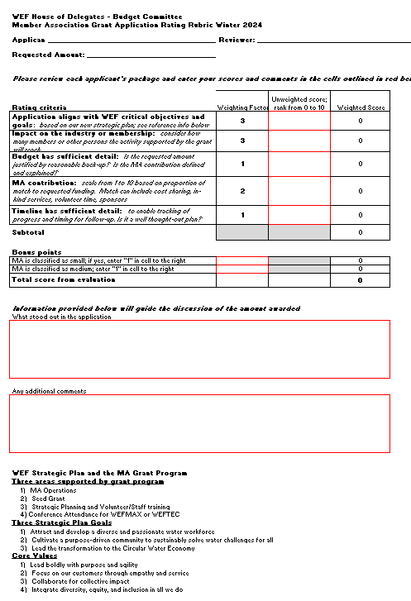
MA grant application scoring worksheet

Slide 36
MA grant application scoring worksheet

Slide 37
Expectations for MA Grant Winners
Carry out the project as proposed
Provide the match as promised
Submit the required (brief) progress reports
Document your results
Share successful ideas with other MAs

Slide 38
WEF House of Delegates DE&I Committee

Slide 39

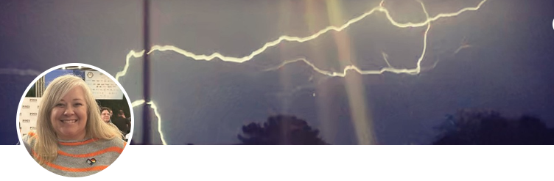
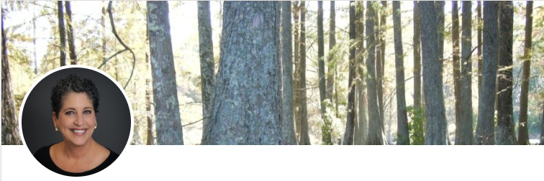
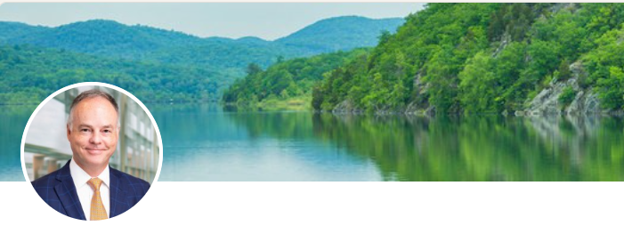
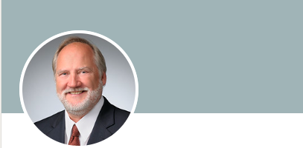


DEI Committee
ValaRae Partee- Chair
Amy Baker- Vice Chair
Ellen Frketic
Peter Garvey
Virgil Lloyd
Rosaleen Nogle
Special shout out to
Ama Richardson

Slide 40
Water Advocacy Committee
Report Out
WEFMAX Park City, UT
Peter Garvey, Delegate-at-Large

Slide 41
History of Water Advocacy at HOD
Started with HOD Workgroup
Graduated to HOD Committee – 23/24 is first year as committee

Slide 42
Committee Members
Co-Chairs
  Peter Garvey & Kristiana Dragash
  Committee Members
    Candice Au-Yeung, Carol Martinson, Janine Burke-Wells, Louis Lambe, Rosaleen Nogle, Louis Storino & Mike Sweeney
  WEF Support
    Steve Dye, Amy Kathman & Kelsey Hurst

Slide 43
Committee Charter
Support Member Association Water Advocacy efforts with a focus on local, state and regional approaches:
Gather and Share Information
Conduct Research
Priority Issues & Position Statements
Other – Promote DC Fly-in, Coordinate w/Delegate at Large

Slide 44
Achievements/Ongoing Activities
Article in WE&T for DC Fly-in (goal = 2 articles/year)
Provide materials for M-A conferences promoting advocacy
Legislative nuggets
Gathering best practices for advocacy across active M-As
Hosting calls highlighting an active M-A
Conduct video interview with legislator
Research what other industries do for advocacy
Research viability of legislative ‘scorecard’
Liaise w/WEF GAC

Slide 45
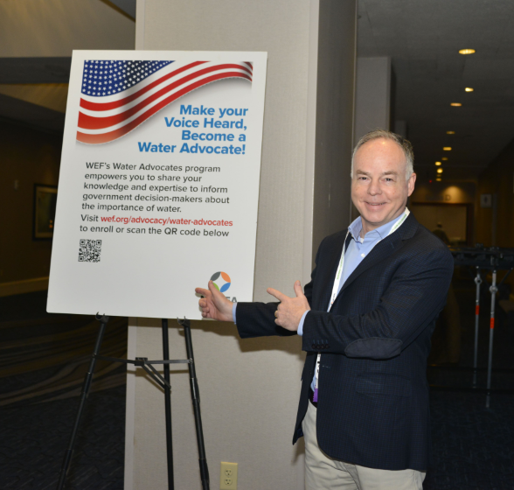
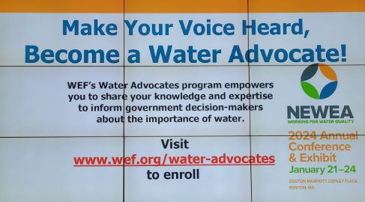
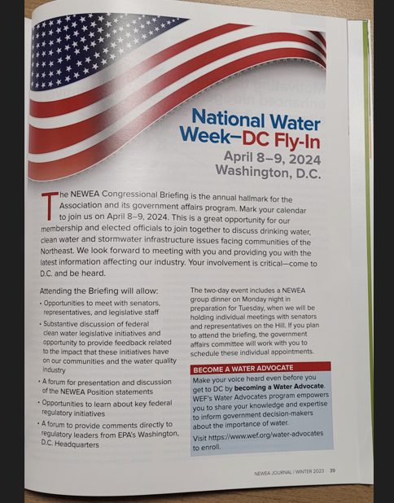
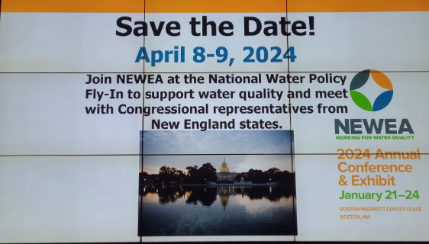
Examples for Your Events

Slide 46
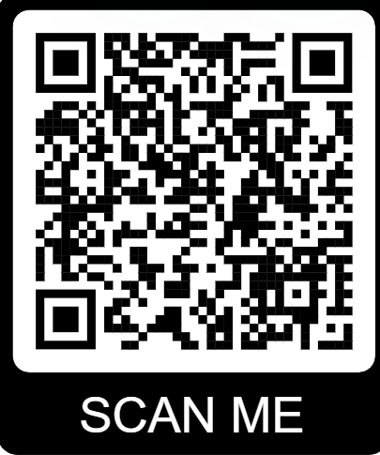
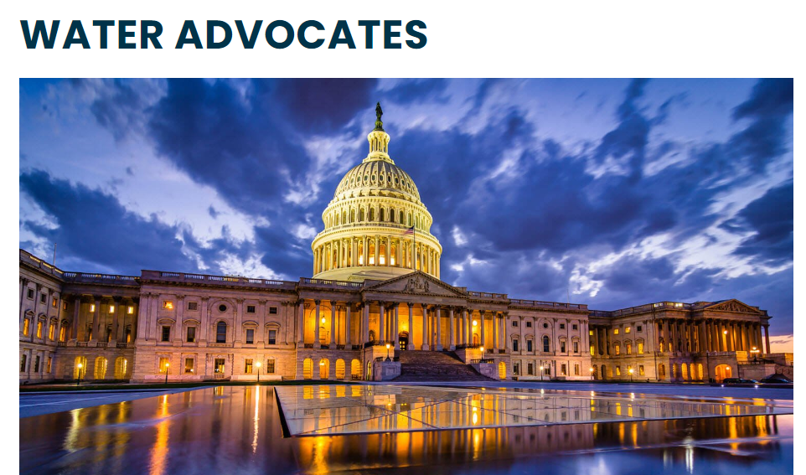
WEF’s Water Advocates Program
BREAKING NEWS!
Aging infrastructure, strict requirements, and continued economic pressures have put unprecedented stress on local governments and agencies that provide essential water services. Elected officials are being called upon to make tough choices that will impact water quality and the viability of our communities for generations to come.
Let’s speak with a loud, united voice for water. The Water Advocates Program helps you to reach out to and connect with elected officials on important water quality issues.
WE NOW HAVE OVER 1,000 WATER ADVOCATES

Slide 47
Questions/Discussion

Slide 48
WEF HOD Strategic Plan Workgroup
Advertising the WEF HOD Challenge!

Slide 49
Advertising WEF HOD Challenge

Slide 50
Advertising WEF HOD Activity
Activity: How would you advertise the WEF HOD?
Chalkboard Advertisement – 30 minutes to create
  Each table to develop an advertisement and/or advertising campaign for WEF HOD and/or WEF HOD Delegate candidate
    Materials provided: Chalk Board, Chalk Markers, Scratch Paper
  Looking for creativity in messaging and audience appeal
    Wording and phrasing
    Artistic elements and use of materials/color/drawing
    Tying in the WEF HOD purpose and attempt at branding for delegate candidates
WEF HOD SP Workgroup Reps Walk Around to Answer Questions
Notes:
Workgroup representative describes the intent of the activity. Can be an advertisement for the HOD or an advertising campaign for a potential HOD representatives.

Slide 51



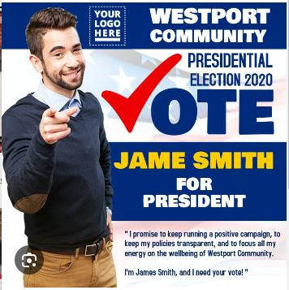


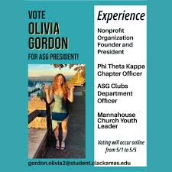

Advertising Campaign Ideas

Slide 52
Advertisement Challenge Presentation
Notes:
How can the HOD do better at >>>>? Expanding upon the team highlighted strengths or weaknesses?
To achieve “doing better” what are one or two things we could do?
Encourage sharing thoughts on concepts?
Work to capture different perspectives based upon their understanding of HOD

Slide 53
House of Delegates Strategic Plan Progress
Notes:
Definition we use: The HOD is…. (elevator speech for what is the HOD)

Slide 54
WEF HOD Strategic Plan Progress
Mission (Draft): To serve as the voice of the Member Associations and constituents - creating a community of water leaders that unites the Member Associations and the Federation.
Vision (Draft): Be the effective/premier/preeminent network of resources supporting water professionals.
Values (Draft):
  Inclusion, equity, diversity
  Service
  Engagement
  Openness
Notes:
Applied information collected from WEFTEC HOD Activity
Values (Draft):
Inclusion, equity, diversity
Service
Representation/service (servant leadership)
Leadership
Advocacy – Internal with MAs and WEF/External with Legislative/Representative empowerment (various ways)
Engagement
Collaboration
Openness
Communication/transparency
Active Listening
Curiosity – Ties to the openness that is there.
Authenticity/Respect

Slide 55
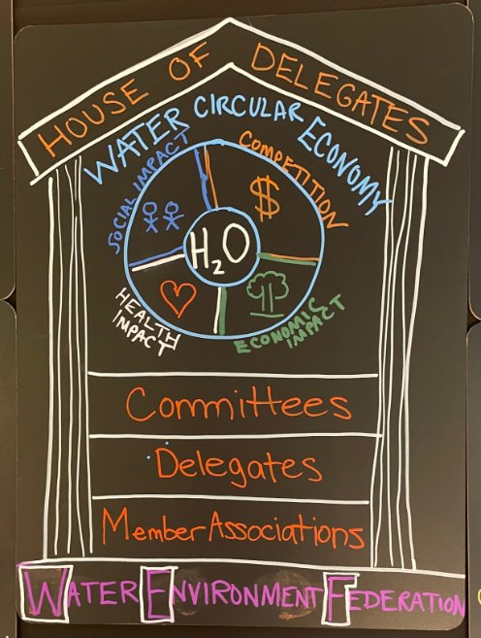
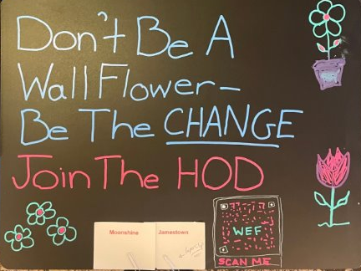
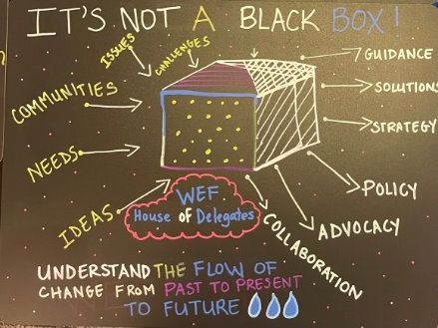
On Behalf of the
WEF HOD Strategic Plan Workgroup
Thank you for Taking the Challenge!

Slide 56
BREAK
10:00 – 10:15 am
Notes:
More information on what the BOT does

Slide 57
WEA of Utah Host Sharing Session

Slide 58
How Diversity Can Help Build Our
Water Workforce
Bill Davis, Speaker-Elect
Cara Jung, Delegate at Large

Slide 59
WHAT IS THE STATE OF OUR WATER WORKFORCE?

Slide 60
“Water utilities across Texas are facing a shortage of qualified personnel to operate their systems…”
Jeremy Mazur, Sr Policy Advisor
Texas 2036

Slide 61
“…The success of any state investment in water infrastructure ultimately hinges on the availability of qualified personnel to operate those systems.”

Slide 62


Strategic Goal #1
Attract and develop a diverse and passionate water workforce

Slide 63


How? We Must First Understand the Workforce
State of the Water Workforce
Brookings Report Research Showed:
  1.7 million Water Workers in 2016
  50% Higher Pay for Entry Level Workers
  85% Male vs 49.6% Nationally
  15% Women vs 46.8% Nationally
  72% White vs 75.5% Nationally
  11.5% are Black or Asian vs 18% Nationally
  53% Have HS Diploma vs 32.5% Nationally
  46.4 Median Age vs 42.2 Nationally

Slide 64
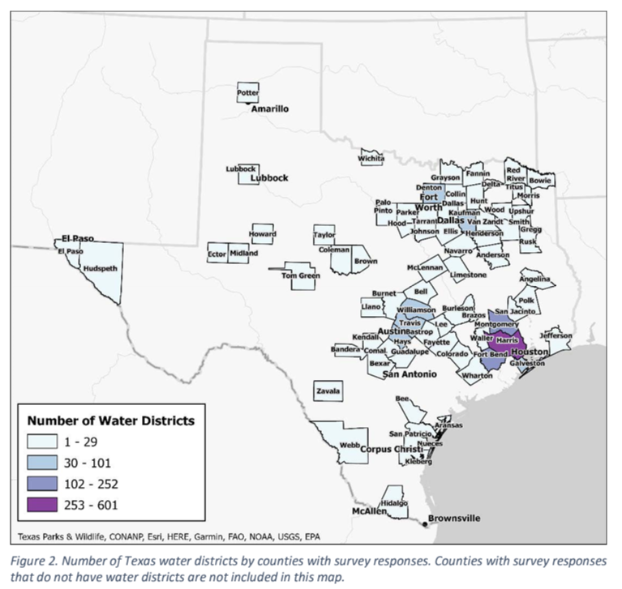

How? We Must First Understand the Workforce
State of the Water Workforce
Texas Water Foundation 2023:
  63% of Respondents Experiencing Workforce challenges
  Talent Attraction
  Competitive Wages
  Talent Retention
  Staffing Shortages
  30% Eligible for Retirement within 5 Years
  20% Retired in Past 5 Years
  Certification Related Issues

Slide 65
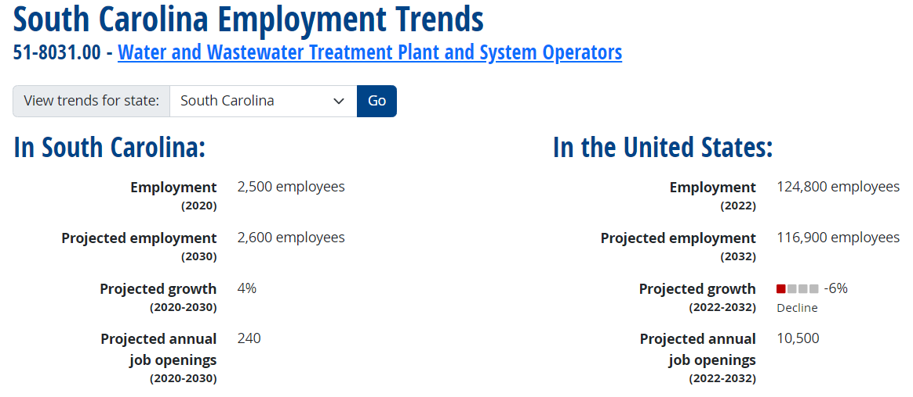
What Does the Future Look Like?
South Carolina Operator Workforce Predictions
South Carolina source: Projections Central 2020-2030 long-term projections external site. United States source: Bureau of Labor Statistics 2022-2032 employment projections external site. "Projected growth" represents the estimated change in total employment over the projections period. "Projected annual job openings" represent openings due to growth and replacement.

Slide 66
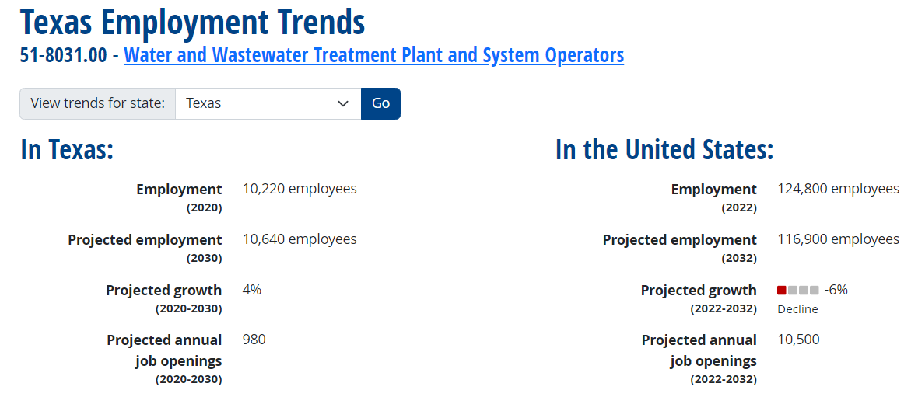
What Does the Future Look Like?
Texas Operator Workforce Predictions
Texas source: Projections Central 2020-2030 long-term projections external site. United States source: Bureau of Labor Statistics 2022-2032 employment projections external site. "Projected growth" represents the estimated change in total employment over the projections period. "Projected annual job openings" represent openings due to growth and replacement.

Slide 67
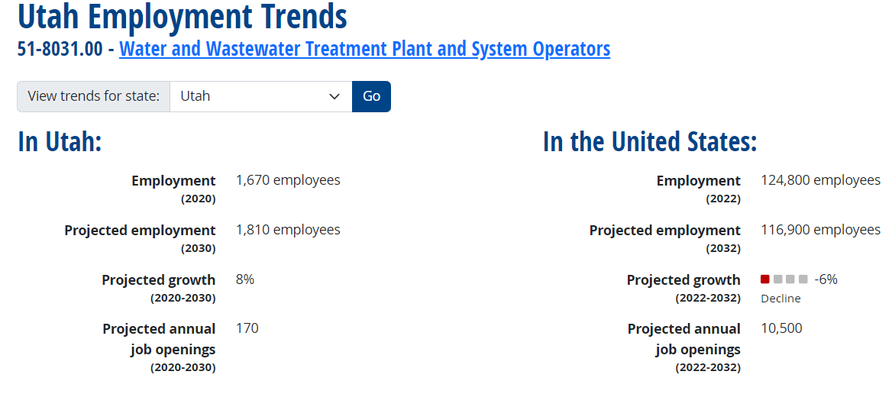
What Does the Future Look Like
Utah source: Projections Central 2020-2030 long-term projections external site. United States source: Bureau of Labor Statistics 2022-2032 employment projections external site. "Projected growth" represents the estimated change in total employment over the projections period. "Projected annual job openings" represent openings due to growth and replacement.

Slide 68
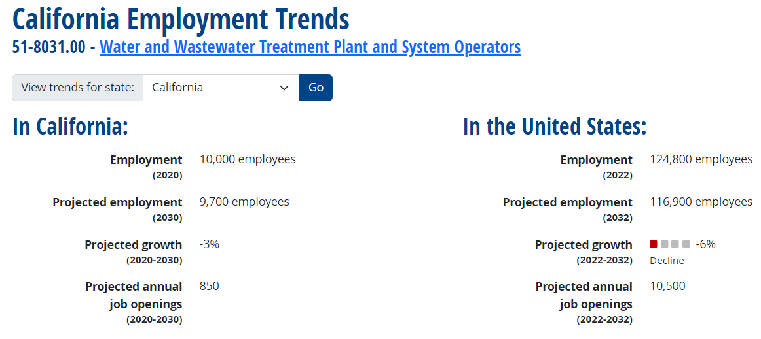
What Does the Future Look Like
California source: Projections Central 2020-2030 long-term projections external site. United States source: Bureau of Labor Statistics 2022-2032 employment projections external site. "Projected growth" represents the estimated change in total employment over the projections period. "Projected annual job openings" represent openings due to growth and replacement.

Slide 69
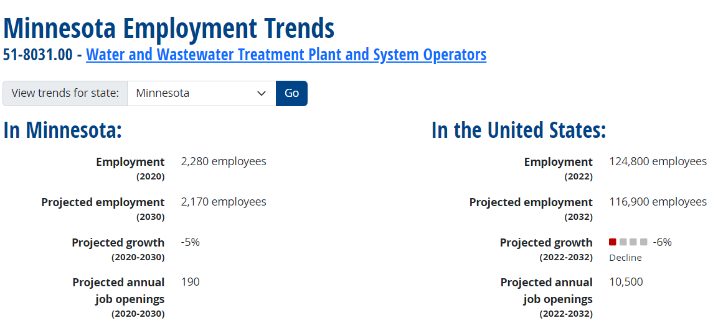
What Does the Future Look Like
Minnesota source: Projections Central 2020-2030 long-term projections external site. United States source: Bureau of Labor Statistics 2022-2032 employment projections external site. "Projected growth" represents the estimated change in total employment over the projections period. "Projected annual job openings" represent openings due to growth and replacement.

Slide 70
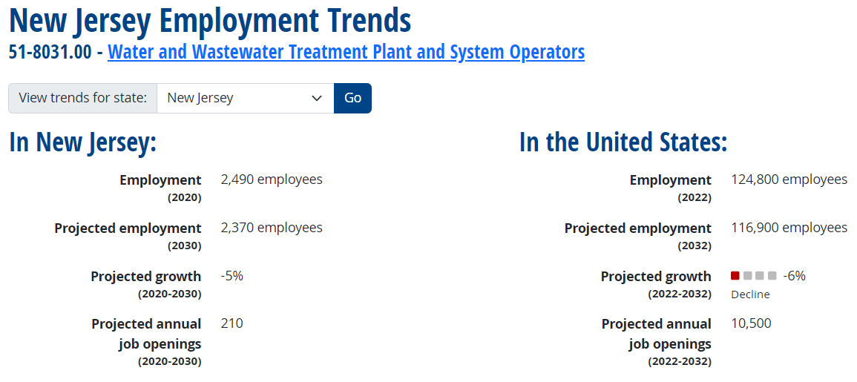
What Does the Future Look Like
New Jersey source: Projections Central 2020-2030 long-term projections external site. United States source: Bureau of Labor Statistics 2022-2032 employment projections external site. "Projected growth" represents the estimated change in total employment over the projections period. "Projected annual job openings" represent openings due to growth and replacement.

Slide 71

What Can We Do?
How Can We Build Our Water Workforce?
House Of Delegates Top Survey Results 2023
  Branding
  Public Relations / Outreach
  Operator Training
  Recruitment
  Student Outreach
  Young Professional Outreach
  Financial Resources
  Support Emerging Leaders

Slide 72




What Can We Do?
How Can We Build Our Water Workforce?
WEF Training Materials
  Wastewater Fundamentals Training
  Wastewater Collections Training
  High School Curriculum
Apprenticeship Programs
Materials for STEM Recruiting
Middle School Career Days
College Student Chapters
$ Incentives for Student Membership
Veteran Programs - 17,038,807 in USA

Slide 73


What Else Can We Do?
How Can We Retain Our Water Workforce?
Think Outside of the Box
Make Sure We Are Recruiting People From Our Customer Base
Allow Staff to Participate in Training at All Levels; Especially YPs
Provide Training Opportunities
Create an Inclusive Culture
Encourage Innovation
Value of Water; We Are Essential

Slide 74
“Diversity encompasses the varying experiences, strengths, skills, perspectives, personal characteristics, cultures, and backgrounds represented by and within the WEF community.”
How WEF Defines Diversity

Slide 75
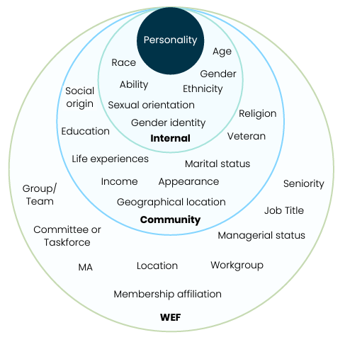
What Does Diversity Look Like at WEF
Dimensions of Diversity* @ WEF
This image shows some of the dimensions of diversity that are present at WEF
  Internal is typically associated with personal identity
  Community is how we relate to society and these are more easily changed
  WEF is the outer circle which captures roles, tenure, and other membership categories within WEF
*Adapted from Gardenswartz and Rowe’s “Four Dimensions of Diversity”

Slide 76
“Diversity is more than race and gender, yes these are easy to measure, but we need to focus on building awareness of water jobs for veterans, as well as, teaching it in middle schools, high schools, colleges, technical schools, and civic and other organizations.”
Bill Davis

Slide 77
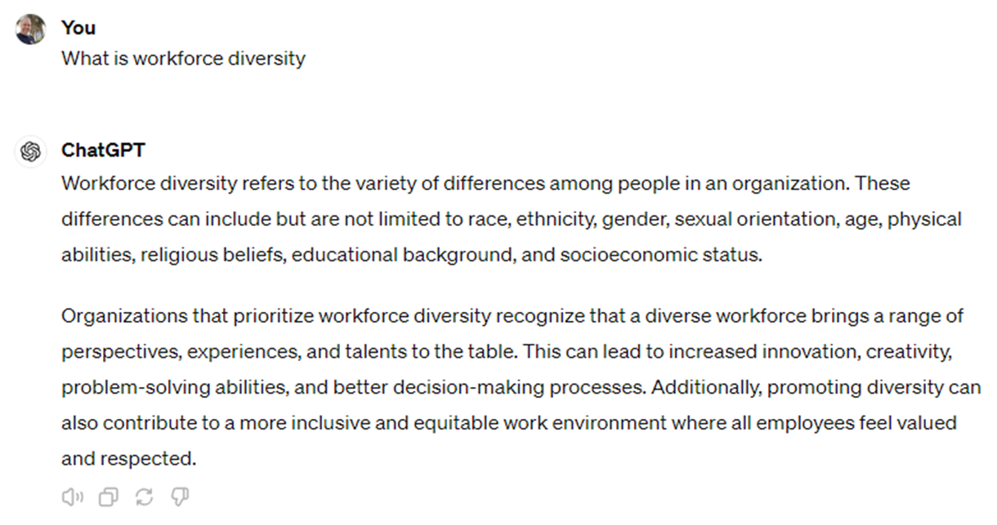

Slide 78
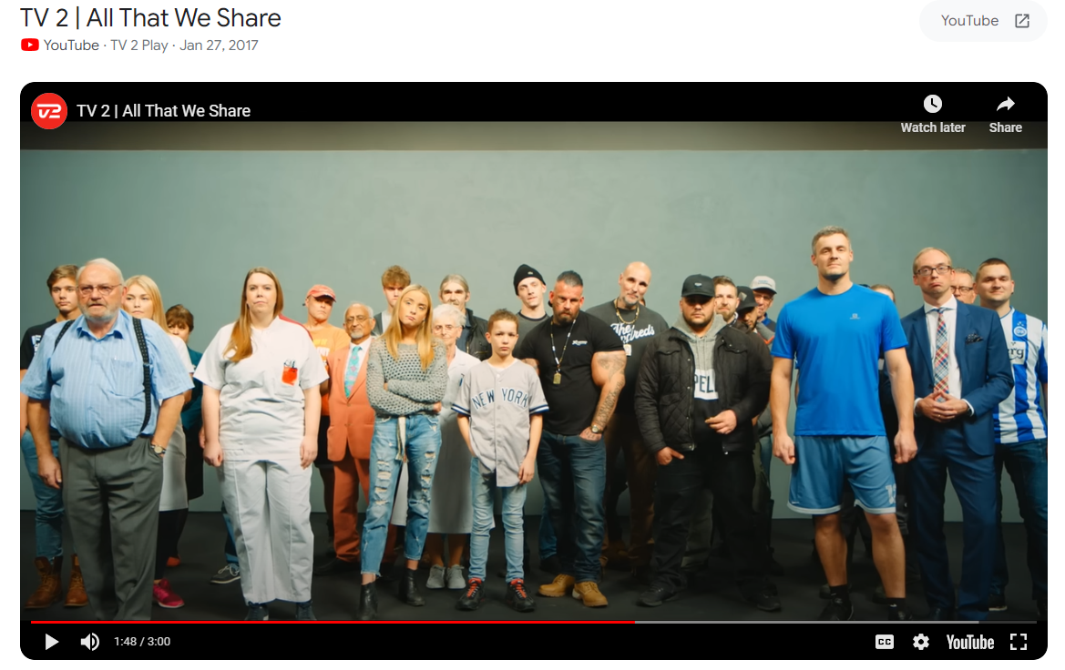
All that We Share…
https://www.youtube.com/watch?v=jD8tjhVO1Tc

Slide 79
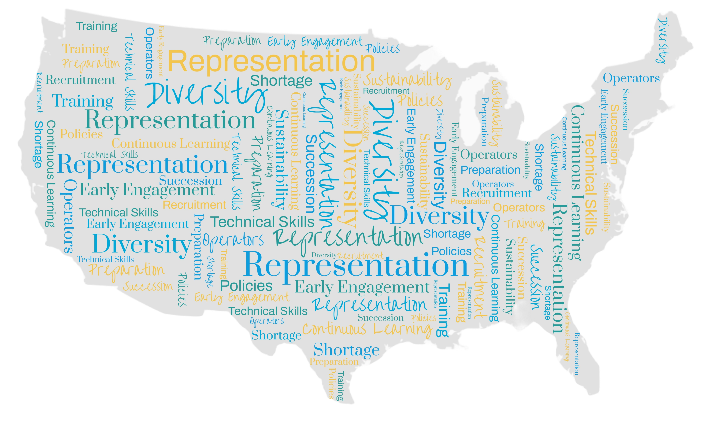
These are some of the responses from the DEI Workgroups Survey on Workforce Development

Slide 80
What is something your MA can do to draw under-represented groups to the water sector, and how can WEF support this?

Slide 81
What are some of the challenges affecting your MA/region that are creating barriers for a diverse workforce?

Slide 82
What are some creative ways your MA has boosted a diverse workforce?

Slide 83

Thank you!

Slide 84
CLOSING
Dave Galbraith
Bill Davis
Kalpna Solanki
Chad Burrell

Slide 85

2025
Oklahoma
New England
California
Dates TBA

Slide 86
Thank you for Attending!

